Slide 1
Role of Interaction in Competitive Optimization
Anima Anandkumar

Slide 2
Single Agent Optimization
Single agent chooses $x$ to minimize $f:ℝ^{m}→ℝ$. $\min_{x∈ℝ^{m}}f\left(x\right)$
Clear Objective: (“Good local”) minimum of $f$
Reliable Baseline: (Stochastic) gradient descent

Slide 3
Competitive Optimization
$x$ and $y$ minimize $f:ℝ^{m+n}→ℝ$ and $g:ℝ^{m+n}→ℝ$ $\min_{x∈ℝ^{m}} f\left(x,y\right), \min_{y∈ℝ^{n}} g(x,y)$
Each objective depends on both players!
Goals will typically conflict ($f≈−g$)

Slide 4
Applications
Constrained optimization
Robust optimization and statistics
Generative adversarial networks (GANs)
Adversarial training
Multi-agent reinforcement learning
Many more?

Slide 5
Simultaneous Gradient Descent (SimGD)
$$x_{k+1}=x_{k}−η∇_{x}f \\ y_{k+1}=y_{k}−η∇_{y}g$$
Competitive analogue of gradient descent?

Slide 6
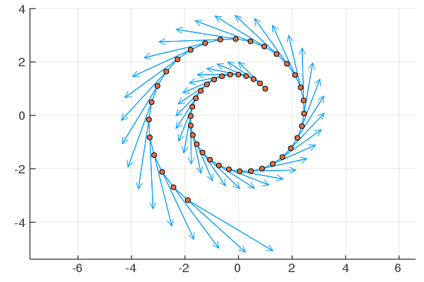
Simultaneous Gradient Descent
Problem: It fails even on simple problems: $f\left(x,y\right)=xy=−g\left(x,y\right)$
Instead of converging to $\left(0,0\right)$, the two players oscillate.
Analogue of “Rock! Paper! Scissor! Rock! Paper! …”.

Slide 7
Simultaneous Gradient Descent
Possible reason of instability in GAN training.
Lots of modifications proposed in the literature
fictitious play (Brown, 1951)
predictive updates (Yadav et al., 2017)
follow the regularized leader (Shalev-Shwartz and Singer, 2007; Grnarova et al., 2017)
opponent learning awareness (Foerster et al., 2018)
optimism (Rakhlin and Sridharan, 2013; Daskalakis et al., 2017; Mertikopoulos et al., 2019), cf also (Korpelevich, 1977)
Consensus optimization (Mescheder et al., 2017)
Symplectic Gradient Adjustment (Balduzzi et al., 2018; Letcher et al., 2019)
…
What is principled generalization of GD to multiple players?

Slide 8
Competitive Gradient Descent
Competitive Gradient Descent
Florian Schäfer and Anima Anandkumar
NeurIPS 2019
https://f-t-s.github.io/projects/cgd/

Slide 9
Revisiting Gradient Descent
The gradient descent update is given as $x_{k+1}−x_{k}={argmin}_{x∈ℝ^{m}} f\left(x_{k}\right)+x^{T}∇_{x}f\left(x_{k}\right)+{\frac{1}{2η}x}^{T}x$

Slide 10
Revisiting Gradient Descent
The gradient descent update is given as $x_{k+1}−x_{k}={argmin}_{x∈ℝ^{m}} f\left(x_{k}\right)+x^{T}∇_{x}f\left(x_{k}\right)+{\frac{1}{2η}x}^{T}x$
Step is solution of a local (linear) approximation

Slide 11
Revisiting Gradient Descent
The gradient descent update is given as $x_{k+1}−x_{k}={argmin}_{x∈ℝ^{m}} f\left(x_{k}\right)+x^{T}∇_{x}f\left(x_{k}\right)+{\frac{1}{2η}x}^{T}x$
Step is solution of a local (linear) approximation
Penalty models limited confidence in approximation.

Slide 12
How to linearize a game?
For two players: Obtain update as solution of local approximation, subject to quadratic penalty expressing the limited confidence of both players.
What is the right way to linearize a game?

Slide 13
Linear or Multilinear?
First attempt: Linear for one player $→$ Linear for two players
$$x_{k+1}−x_{k}={argmin}_{x∈ℝ^{m}} f+x^{T}∇_{x}f+y^{T}∇_{y}f+{\frac{1}{2η}x}^{T}x \\ y_{k+1}−y_{k}={argmin}_{y∈ℝ^{n}} g+x^{T}∇_{x}g+y^{T}∇_{y}g+{\frac{1}{2η}y}^{T}y$$
No interaction between the two players $→$ We recover alternating gradient descent

Slide 14
Linear or Multilinear?
Second attempt: Linear for one player $→$ Bilinear for two players $x_{k+1}−x_{k}={argmin}_{x∈ℝ^{m}} f+x^{T}∇_{x}f+{x^{T}D}_{xy}^{2}f y+y^{T}∇_{y}f+{\frac{1}{2η}x}^{T}x$ $y_{k+1}−y_{k}={argmin}_{y∈ℝ^{n}} g+x^{T}∇_{x}g+x^{T}D_{xy}^{2}g y+y^{T}∇_{y}g+{\frac{1}{2η}y}^{T}y$
The local approximation is interactive!
Does it have a Nash equilibrium?

Slide 15
Solving for the Nash Equilibrium
Theorem: Among all (possibly randomized) strategies with finite first moment, the local game has a unique Nash equilibrium given by $x=−η{\left(Id −η^{2}D_{xy}^{2}f D_{yx}^{2}g\right)}^{−1}\left(∇_{x}f −ηD_{xy}^{2}f ∇_{y}g\right)$ $y=−η{\left(Id −η^{2}D_{yx}^{2}g D_{xy}f\right)}^{−1}\left(∇_{y}g −ηD_{yx}^{2}g ∇_{x}f\right)$
Can use Equilibrium as update rule.

Slide 16
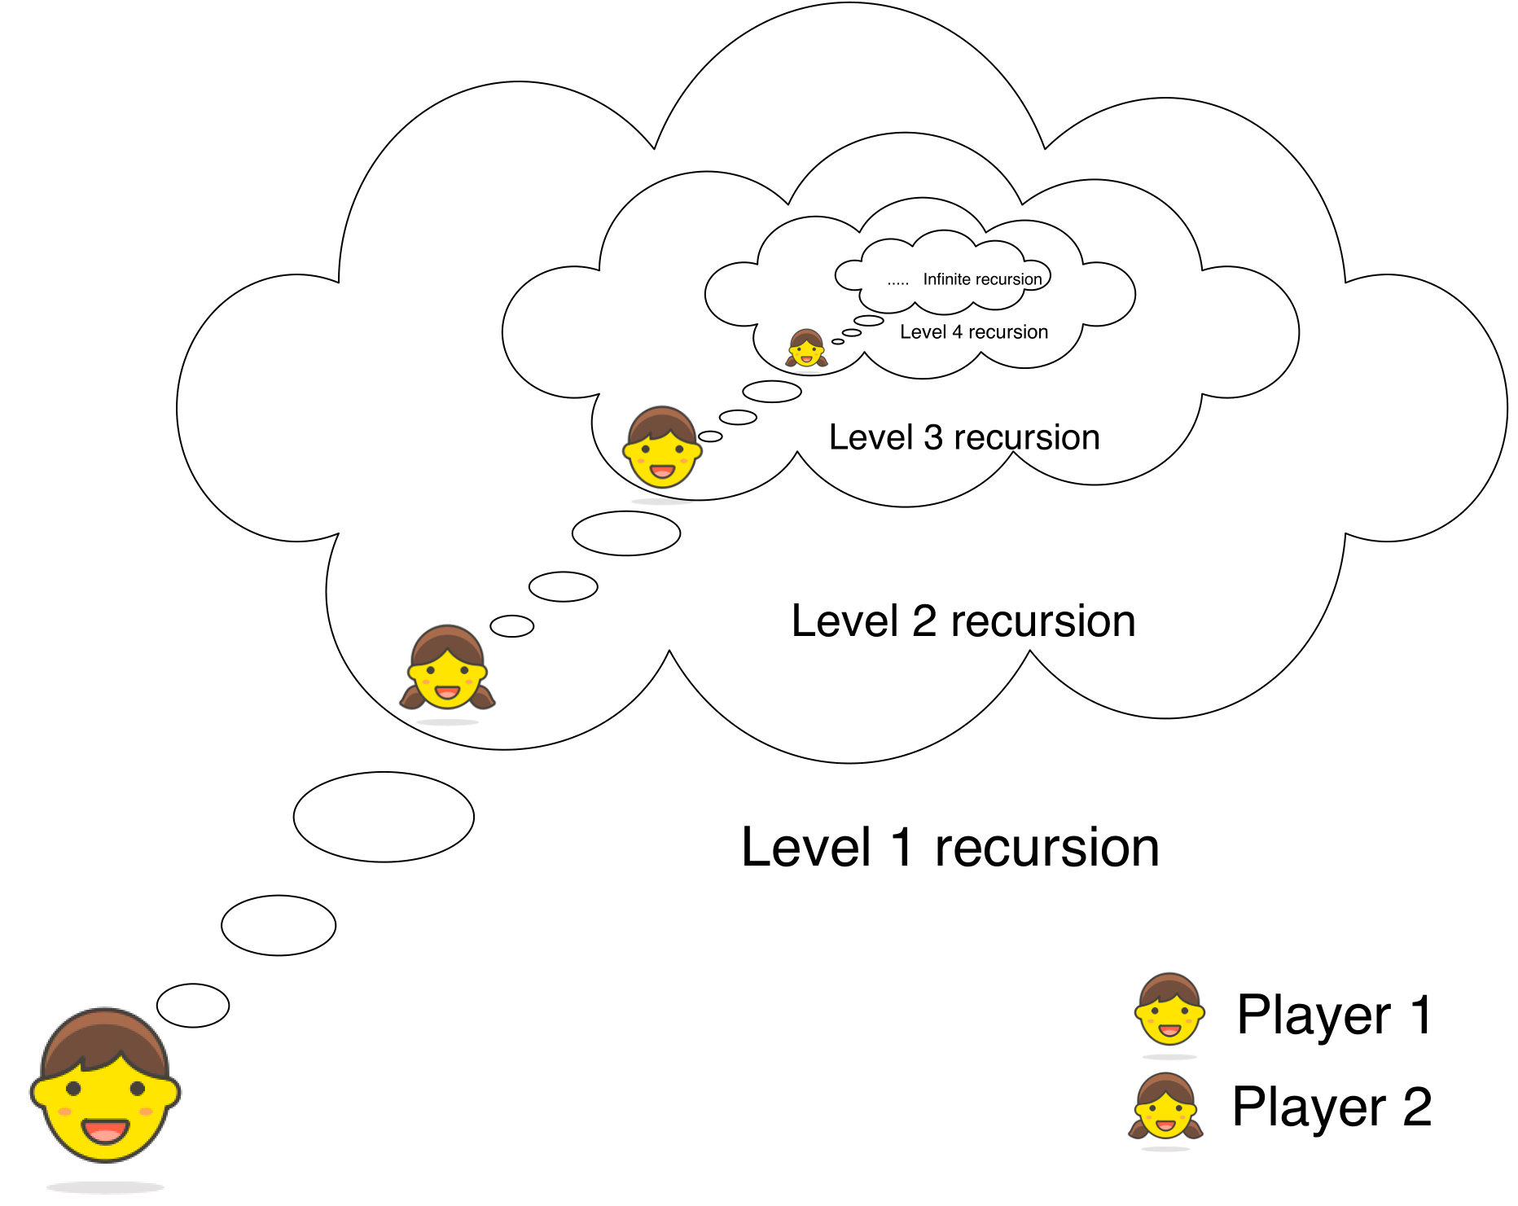
What I think that they think that I think...
We can also write the update rule as $\left(\begin{matrix}x_{k+1}−x_{k} \\ y_{k+1}−y_{k}\end{matrix}\right)=−η{\left(\begin{matrix}Id & ηD_{xy}^{2}f \\ ηD_{yx}^{2}g & Id\end{matrix}\right)}^{−1}\left(\begin{matrix}∇_{x}f \\ ∇_{y}g\end{matrix}\right)$
For $λ_{max}\left(A\right)<1$ we can write ${\left(Id −A\right)}^{−1}=\sum_{k=0}^{∞}{A^{k}}$
First partial sum: Optimal if the other player stays constant.
Second partial sum: Optimal if the other player thinks the other player stays constant
Third partial sum: Optimal if the other player thinks the other player thinks the other player stays constant …
Graphics, courtesy of Manish Prajapat

Slide 17
What I think that they think that I think...
For small enough $η$ we recover the Nash equilibrium in the limit.
Can invert matrix using Neumann series. Recovers higher order LOLA (Foerster et al., 2018)
Krylov subspace methods more efficient!

Slide 18
Why bilinear makes sense
Bilinear lies “between first and second order”
Usually first (SimGD) or second order (Newton)
We believe: Bilinear is the right way to approximate games to first order, for fundamental reasons!

Slide 19
Getting the invariances right!
First and second order are invariant under coordinate changes:
Change coordinate system
$$→$$
Compute local approximation
$$→$$
Change coordinate system back
Compute local approximation

Slide 20
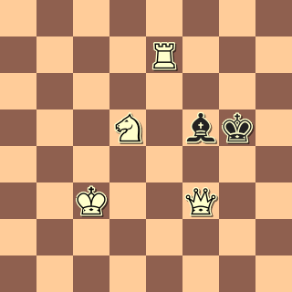
Getting the invariances right!
But “changing coordinates” in two player game can change the game!
$$x=\left(\begin{matrix} \\ \\ \end{matrix}\right)$$
$$x=\left(\begin{matrix} \\ \\ \end{matrix}\right)$$
$$y=\left(\begin{matrix} \\ \end{matrix}\right)$$
$$y=\left(\begin{matrix} \\ \end{matrix}\right)$$
Bilinear is only invariant to changes within each player’s space in isolation!

Slide 21
Further Reasons
Newton’s method also attracted to local worst strategies!
Bilinear highest order with quadratic regularization that guarantees locally optimal updates!
Often $D_{xy}^{2}f$well defined while $D_{xx}^{2}f$is not: Bilinear fully exploits regularity while not imposing more stringent requirements

Slide 22
Competitive Mirror Descent
Competitive mirror descent
Florian Schäfer, Anima Anandkumar, and Houman Owhadi

Slide 23
The Problem:
Constrained Competitive Optimization: $\min_{x∈𝒞}{f(x}, y) \min_{y∈𝒦}{g(x, y)}$
How to combine CGD with constraints?

Slide 24
Empty Threats:
Projected CGD (PCGD): Alternate CGD steps and projection onto the feasible set
Problem: Fails even for simple convex sets, due to players reacting to empty threats

Slide 25
Empty Threats:
Example: $\min_{x≥0}{\max_{y≥0}{2xy −{\left(1 −y\right)}^{2}}}$
Nash equilibrium is $\left(x,y\right)=\left(0,1\right)$
$∇_{x}f\left(0,1\right)=2$, thus $x_{k+1 }<0$ under CGD
In anticipation $y_{k+1 }>1$ under CGD

Slide 26
Empty Threats:
Example: $\min_{x≥0}{\max_{y≥0}{2xy −{\left(1 −y\right)}^{2}}}$
Thus, $y$ leaves the optimal value
But $x_{k+1}$ is projected back to zero
$y$ reacted to empty threat

Slide 27
Mirror Descent:
In PCGD, local update unaware of constraints
In Mirror Descent, Bregman divergence informs local update of global geometry. $x_{k+1 }={argmin}_{x} {[D}_{x}f]\left(x −x_{k}\right)+𝔻(x|\left|x_{k}\right)$
KL divergence leads to multiplicative weights $𝔻_{KL}\left(x||y\right)=\sum_{i}{x_{i}}\log\left(\frac{x_{i}}{y_{i}}\right) −x_{i}+y_{i}$

Slide 28
Constrained Competitive Optimization
 | Single agent | Competitive
Unconstrained | Gradient Descent | Competitive Gradient Descent
Constrained | Mirror Descent | Competitive Mirror Descent

Slide 29
Constrained Competitive Optimization
Naïve approach: replace quadratic penalty with Bregman Divergence
Problem with this approach:
Local problem is nonlinear $→$ Linear algebra not enough to solve
$$x_{k+1}−x_{k}={argmin}_{x∈ℝ^{m}} f+x^{T}∇_{x}f+{x^{T}D}_{xy}^{2}f y+y^{T}∇_{y}f+𝔻\left(x+x_{k}||x_{k}\right) \\ y_{k+1}−y_{k}={argmin}_{y∈ℝ^{n}} g+x^{T}∇_{x}g+x^{T}D_{xy}^{2}g y+y^{T}∇_{y}g+𝔻\left(y+y_{k}||y_{k}\right)$$

Slide 30
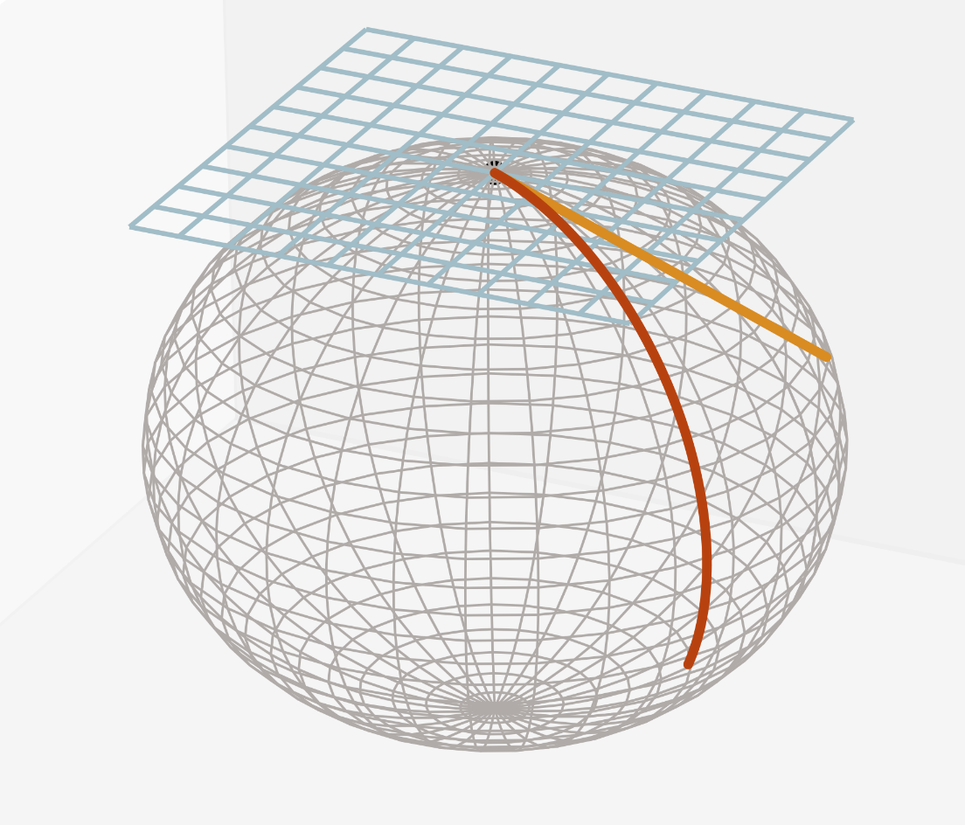
Basic Notions of Differential Geometry
Tangent space $𝒯_{p}ℳ$: Velocities of movement from $p$ on $ℳ$
Riemannian metric $g_{p}(⋅,⋅)$: Magnitude/Speed of elements of $𝒯_{p}ℳ$
Exponential map ${Exp}_{p}\left(⋅\right)$: Destination when going straight on $ℳ$ with constant velocity for unit time

Slide 31
Information Geometry of Bregman Divergences
$𝔻_{ψ}\left(p||q\right)=ψ\left(p\right) −ψ\left(q\right)−\left[Dψ\left(q\right)\right]\left(p −q\right)$
Riemannian Metric: $2g_{p}\left(x,x\right)=\frac{x^{⊤}\left[D^{2}ψ\left(p\right)\right]x}{2}=\frac{d^{2}}{dr^{2}}𝔻\left(p+rx||p\right){\left.​\right|}_{r=0 }$
Exponential map: ${Exp}_{p}^{ψ}\left(x\right)=\left(Dψ\right)\left({\left(Dψ\right)}^{−1}+\left[D^{2}ψ\left(p\right)\right]x\right)$

Slide 32
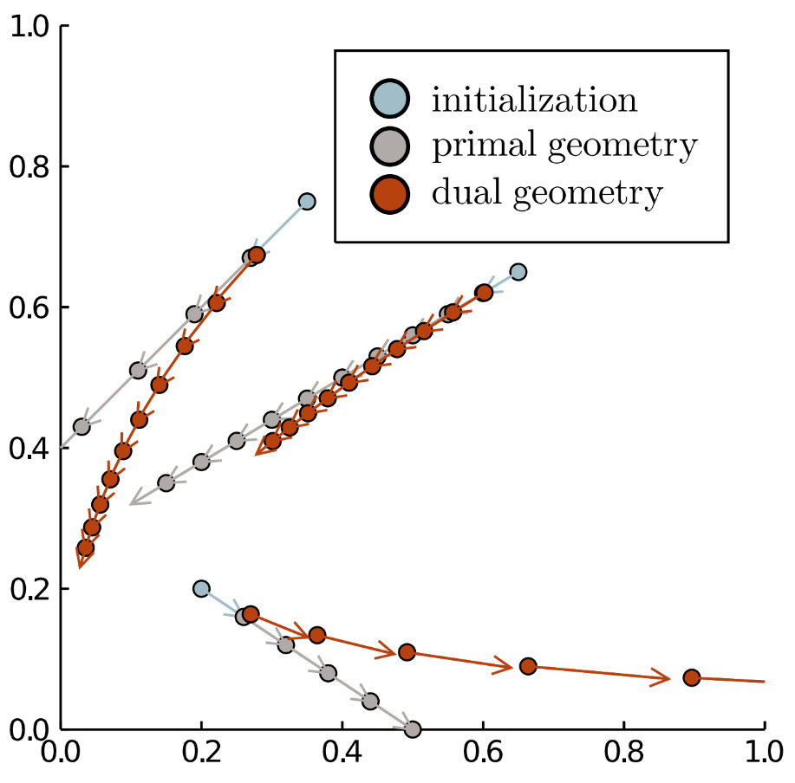
Information Geometry of KL Divergence
Fisher-Rao metric: $g_{p}\left(x,x\right)=$ $\frac{\sum_{i}{x_{i}^{2}}}{p_{i}}$
Straight lines on logarithmic scale: ${\left({Exp}_{p}^{ψ}\left(x\right)\right)}_{i}=exp\left(log\left(p_{i}\right)+\frac{x_{i}}{p_{i}}\right)=p_{i}exp\left(\frac{x_{i}}{p_{i}}\right)$

Slide 33
Information Geometry of Mirror Descent
Can recast mirror descent: [Raskutti and Mukherjee, 2015]
Choose a direction of movement as $Δx=\underset{x∈𝒯_{x_{k}}ℳ}{argmin} \left[D_{x}f\right]x+g_{x_{k}}^{ψ}\left(x, x\right)$
Obtain $x_{k+1}$ by moving in this direction $x_{k+1 }={Exp}_{x_{k}}^{ψ}\left(Δx\right)$

Slide 34
Competitive Mirror Descent
Choose a direction of movement as $Δx=\underset{x∈𝒯_{x_{k}}ℳ}{argmin} \left[D_{x}f\right]x+x^{⊤}\left[D_{xy}^{2}f\right]y+\left[D_{y}f\right]y+g_{x_{k}}^{ψ}\left(x, x\right)$ $Δy=\underset{y∈𝒯_{x_{k}}ℳ}{argmin} \left[D_{x}g\right]x+x^{⊤}\left[D_{xy}^{2}g\right]y+\left[D_{y}g\right]y+g_{y_{k}}^{φ}\left(y, y\right)$
Obtain $x_{k+1 }$ and $y_{k+1}$ by moving in this direction $x_{k+1 }={Exp}_{x_{k}}^{ψ}\left(Δx\right)$ $y_{k+1 }={Exp}_{y_{k}}^{φ}\left(Δy\right)$

Slide 35
Conclusion (CGD + CMD)
We generalize gradient descent to competitive optimization
Use Nash equilibrium of bilinear approximation as update
Update aware of competition $→$improved convergence property
Generalization of mirror descent allows to treat constraints
Information geometric view motivates efficient algorithm

Slide 36
Application (I): Constrained Optimization

Slide 37
Lagrangian Duality:
Consider constrained optimization problem $\min_{\begin{aligned}g\left(x\right)=0 \\ h\left(x\right)≤0\end{aligned}}{f(x)}⇔\min_{x}{\max_{\begin{aligned}λ \\ μ≥0\end{aligned}}{f\left(x\right)+λg\left(x\right)+μh(x)}}$
Consider competitive problem
$$\min_{x}{f\left(x\right)+λg\left(x\right)+μh\left(x\right)} \min_{\begin{aligned}λ \\ μ≥0\end{aligned}}{−λg\left(x\right)−μh\left(x\right)}$$
Equivalent under Slater’s condition

Slide 38
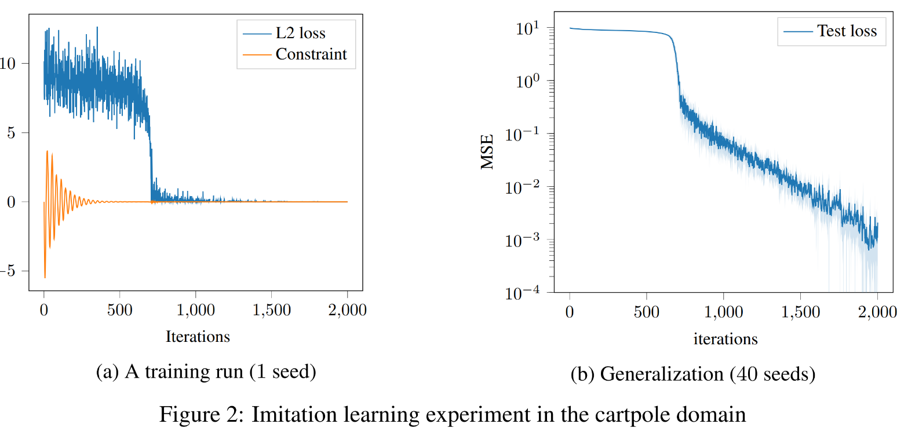
Applications in Inverse Reinforcement Learning:
[Bacon et al. 2019] use Lagrange multipliers and CGD for inverse reinforcement learning
Paper:
``A Lagrangian Method for Inverse Problems in Reinforcement Learning’’ (Pierre-Luc Bacon, Florian Schäfer, Clement Gehring, Anima Anandkumar, and Emma Brunskill)
Code: https://github.com/gehring/fax

Slide 39
Applications in Computer Graphics:
Example: Clebsch variables
Map from $ℳ$ to $S^{2}$ s.t. Jacobian has unit determinant
Model divergence free quantities in fluid mechanics, magnetodynamics
For details, see [Inside fluids: Clebsch maps for visualization and processing, Chern et al. 2017]
Courtesy of Albert Chern, Marcel Padilla, and Peter Schroeder

Slide 40
Applications in Computer Graphics:
Example: Constrained minimization of Willmore Energy
Lagrange multipliers are used to enforce geometric constraints
Courtesy of Yousuf Soliman and Peter Schroeder

Slide 41
Applications in Computer Graphics:
Competitive Gradient Descent
Augmented Lagrangian
Courtesy of Yousuf Soliman and Peter Schroeder

Slide 42
Application (II): Multi-agent RL

Slide 43
Competitive Policy Gradient:
Prajapat et al. propose to use CGD in multi-agent RL
Competitive policy gradient theorem for Hessian vector products
Resulting competitive policy gradient (CoPG) greatly improves quality of learned policies
Paper:
``Competitive Policy Optimization’’ (Manish Prajapat, Kamyar Azizzadenesheli, Alexander Liniger, Yisong Yue, and Anima Anandkumar)
Code: https://github.com/manish-pra/copg/
https://github.com/manish-pra/trcopo/

Slide 44
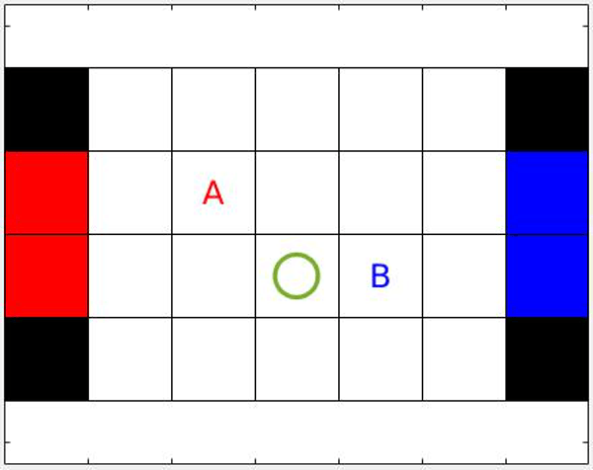
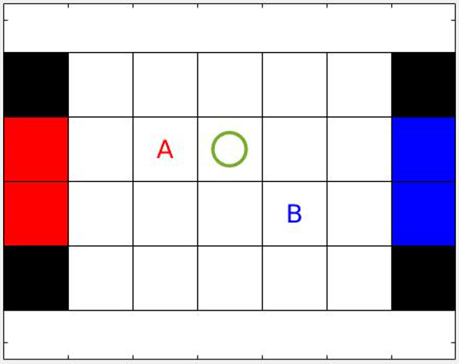
Markov Soccer:
Discrete State Space: Markov Soccer
Simultaneous policy gradient
Competitive policy gradient
Under CoPG, agents learn to defend!

Slide 45
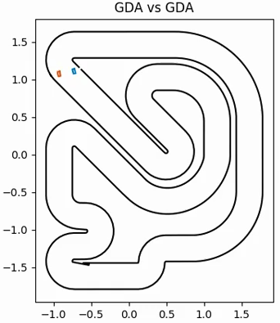
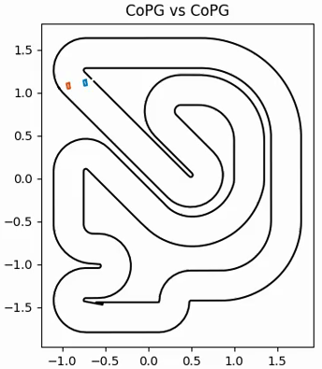
Car Racing:
Continuous state space: Car racing
Instantaneous reward is difference in progress: $$Δρ_{1}−Δρ_{2}$$
Collision with track: $$→Δρ=0, until end$$
Collision with other car $$→Δρ=0 for 0.2s$$ for rear car
Simultaneous policy gradient
Competitive policy gradient

Slide 46
Application (III): GANs That’s a longer story…

Slide 47
Implicit competitive regularization
Implicit competitive regularization in GANs
Florian Schäfer, Hongkai Zheng, and Anandkumar, Anima
ICML 2020
https://f-t-s.github.io/projects/icr/

Slide 48
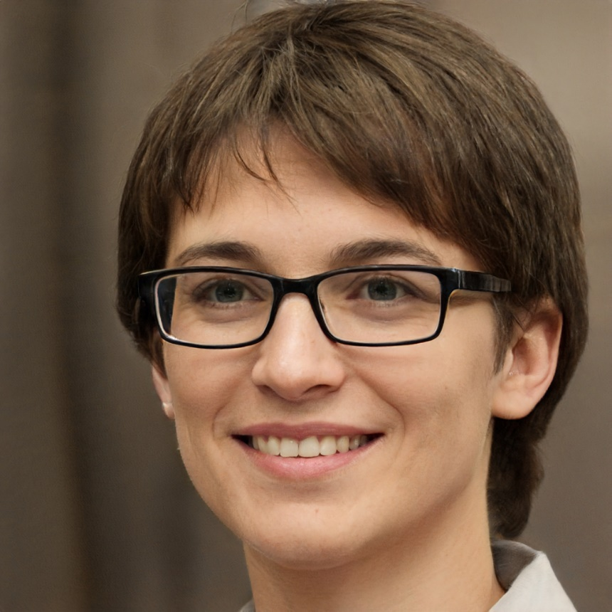
Why do GANs work?
GANs generate images using adversarial training
Vastly superior image quality compared to VAE
Why do they work?
Produced by StyleGan2 on https://thispersondoesnotexist.com/

Slide 49
The minimax interpretation:
Original formulation: $\min_{𝒢} \max_{𝒟} 𝔼_{x∼P_{data} }\left[log\left(𝒟\left(x\right)\right)\right]+𝔼_{z∼𝒩}\left[log\left(1 −𝒟\left(𝒢\left(z\right)\right)\right)\right]$
Max over $𝒟$ yields Jensen-Shannon divergence $\min_{𝒢} JSD\left(𝒢, P_{data}\right)$
Common interpretation: GAN $≈$ minimizes JSD
Other GAN variants minimize other metrics/divs.

Slide 50
The GAN-dilemma:
Minimax interpretation has fundamental problem
Without regularity constraints, discriminator can (almost) always be perfect
Imposing constraints needs measure of similarity of images, which is hard to obtain.

Slide 51
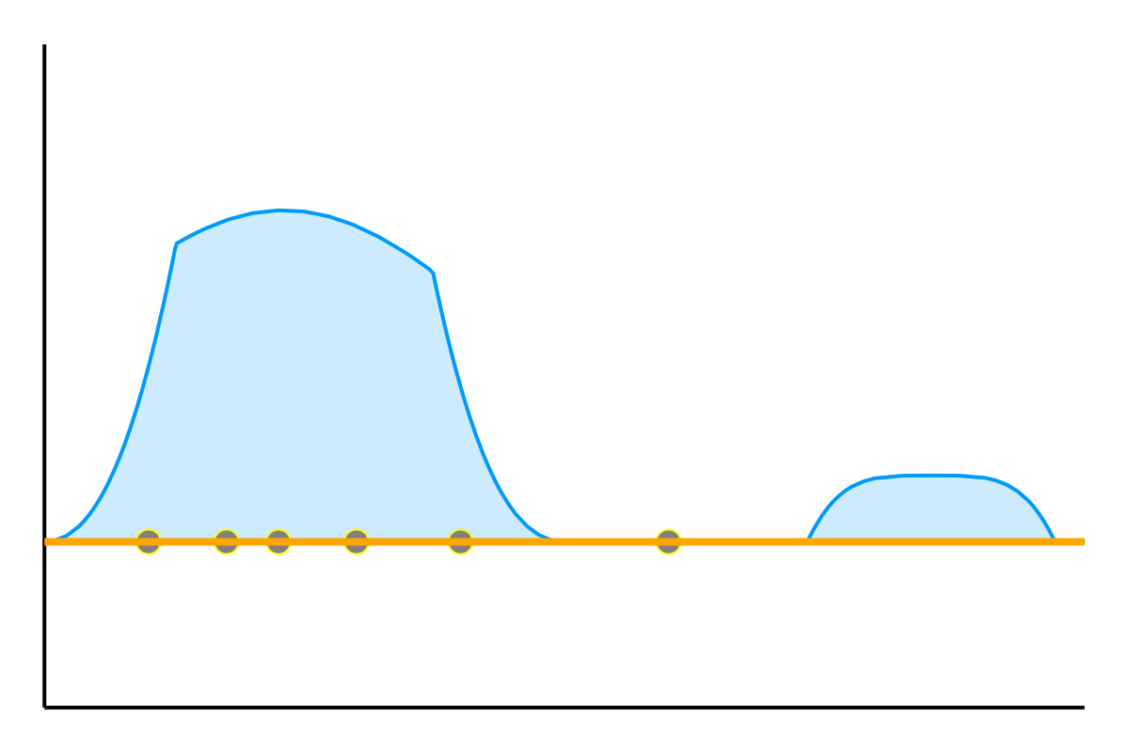
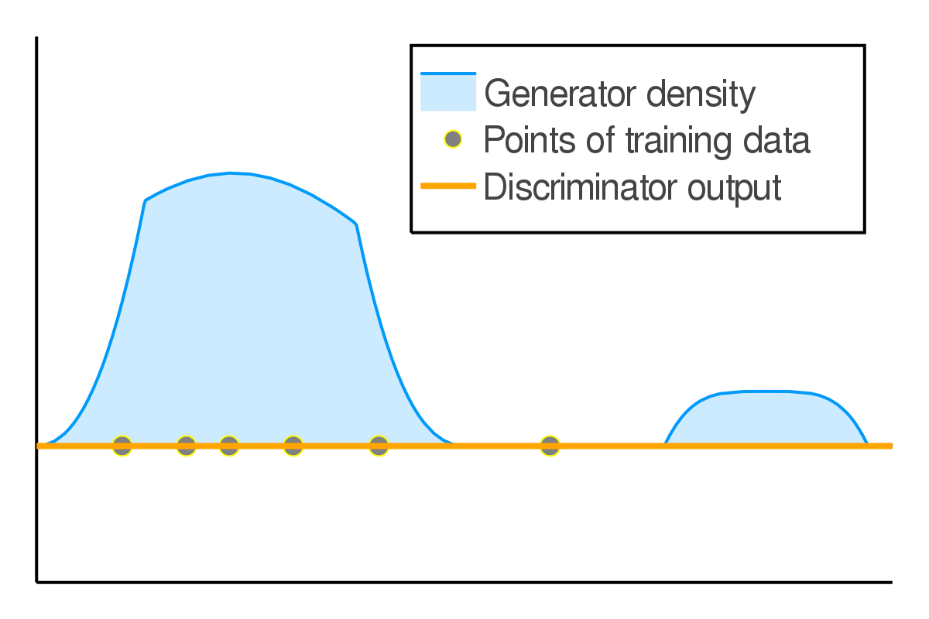
Unconstrained discriminators:
Unconstrained discriminators can (almost) always be perfect:
What the discriminator should do:
What it could do instead:

Slide 52
Adding constraints:
Idea: Regularize the discriminator.
Example : WGAN $\min_{𝒢}\max_{𝒟: ||∇𝒟||≤1}𝔼_{x∼P_{data}}\left[𝒟\left(x\right)\right]−𝔼_{z∼𝒩}\left[𝒟\left(𝒢\left(z\right)\right)\right].$
Constraint on $∇𝒟$ prevents pointy discriminators.
But how to choose $||⋅||$? Requires similarity metric

Slide 53
Implicit competitive regularization
SimGD has stable points, unstable for GD
$$\min_{x} \max_{y} x^{2}+10xy+y^{2}$$
Optimal $y→∞$ but in SimGD $\left(x,y\right)→(0,0)$
$$η_{x}=0.09$$
$$η_{y}=0.01$$

Slide 54
Implicit competitive regularization
Commonly seen as flaw of SimGD
Simultaneous updates introduces regularization: ICR
$$η_{x}=0.09$$
$$η_{y}=0.01$$

Slide 55
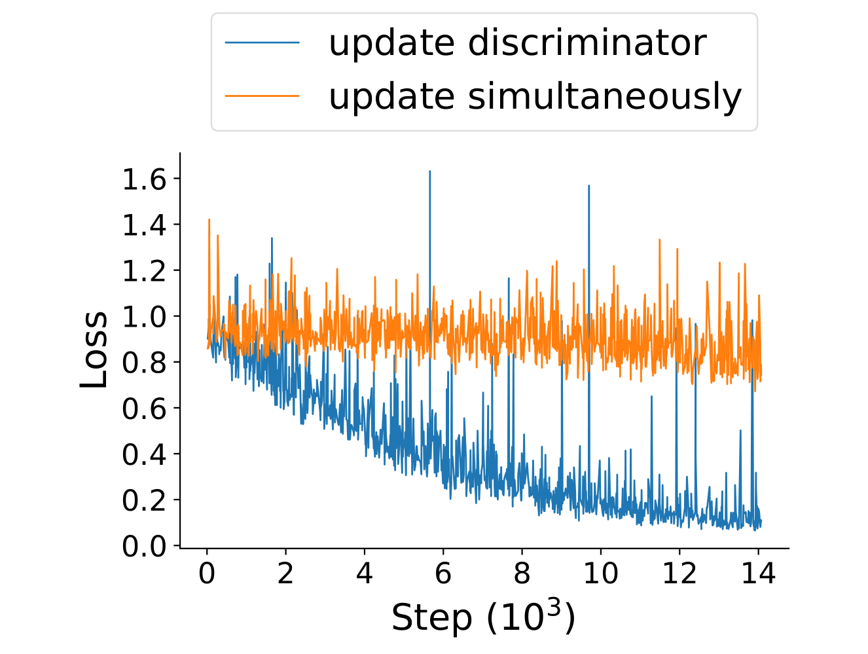
ICR in the wild
Train GAN on MNIST to good checkpoint
Continue training with either SimGD or GD

Slide 56
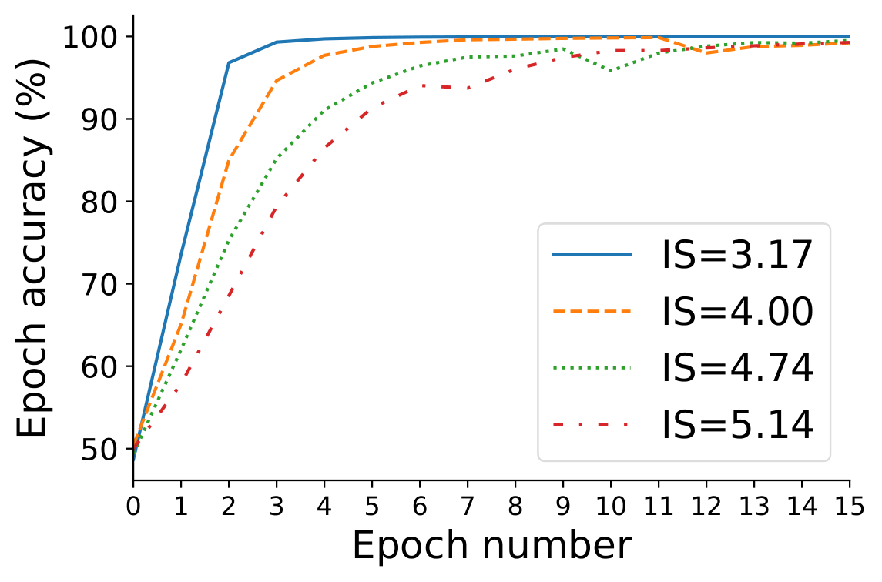
Hypothesis on NN behavior
Hypothesis: Visually obvious mistakes are identified more quickly by the discriminator
Evidence on CIFAR 10:

Slide 57
Thesis: ICR enables GANs
ICR selects critical points where the discriminator learns only slowly
These correspond to realistic images
Thus, ICR allows GANs to use inductive biases of NN for generative modeling

Slide 58
Strengthening ICR
GANs suffer from training instabilities
Could stronger ICR stabilize training?
In CGD, agents always account for each other
Strengthens stabilization by ICR

Slide 59
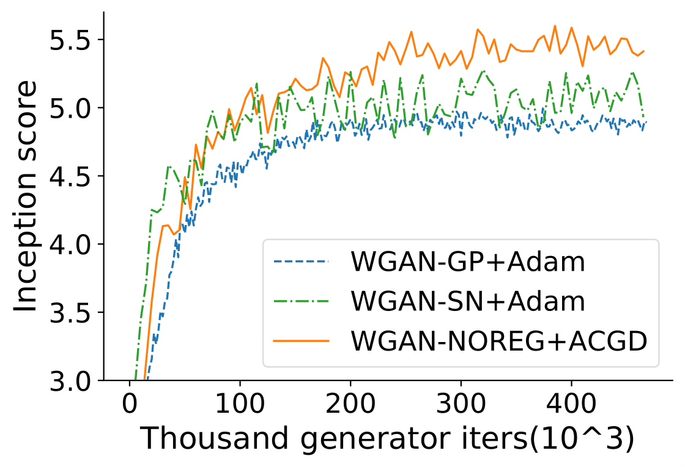
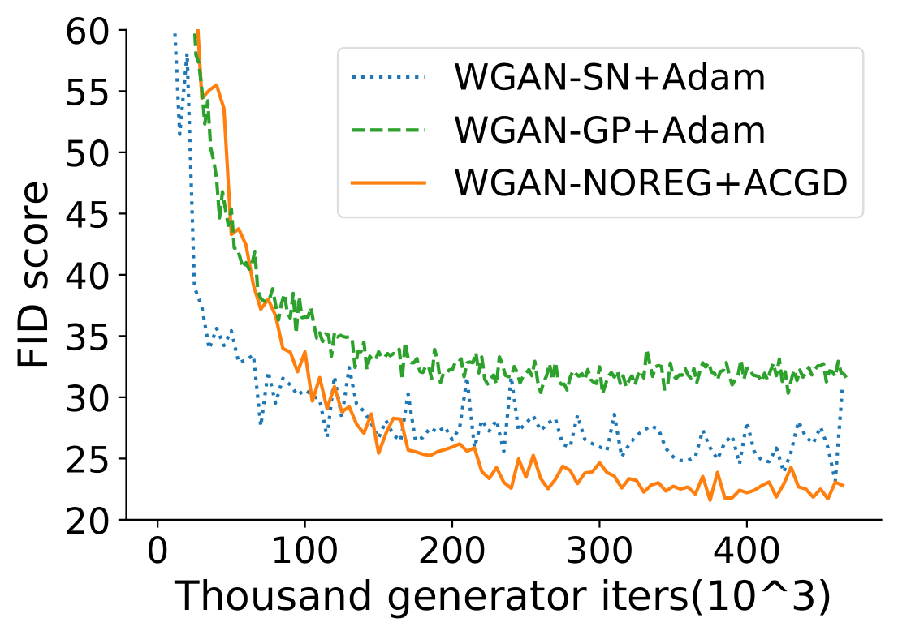
CGD for stronger ICR
Experiments on CIFAR10:
Use WGAN-GP model, remove gradient penalty, train with (adaptive) CGD.
Check out pytorch package written by Hongkai under https://pypi.org/project/CGDs/0.0.1/

Slide 60
Conclusion (ICR)
GAN-dilemma foils past explanations of GANs
ICR explains GAN performance based on dynamics of simultaneous training
Motivates to use CGD for stronger ICR
Improved IS and FID using CGD on CIFAR 10

Slide 61
Overall Conclusion
Use local Nash equilibrium as update rule for competitive optimization
Interaction-awareness improves convergence
Impact on a wide range of applications
Implicit competitive regularization in GANs the use of CGD which improves training stability

