Slide 1
CMS 165 Lecture 11
Approximation and Generalization in
Neural Networks

Slide 2
Decomposition of Errors

Slide 3
Classical NN theory

Slide 4
Recall from previous lecture:
Hypothesis class: $h∈H;h:X→Y$
A loss function: $l\left(Y,h\left(X\right)\right)∈R, e.g., 𝕀(Y≠h(X))$
Expected risk: $L\left(h\right):=E_{P}\left[l\left(Y,h\left(X\right)\right)\right]$
Expected risk minimizer: $h^{∗}∈\arg{\min_{h∈H}{L\left(h\right)}}$
Given a set of samples: ${\left\{x_{i},y_{i}\right\}}_{i}^{n}$
Empirical risk: $\hat{L}\left(h\right)≔\frac{1}{n}\sum_{i}^{n}{l\left(y_{i},h\left(x_{i}\right)\right)}$
Empirical risk minimizer: $\hat{h}∈\arg{\min_{h∈H}{\hat{L}\left(h\right)}}$
$$P$$
$$X,Y∼P$$

Slide 5
Recall Measures of Complexity
$L\left(\hat{h}\right) −L\left(h^{∗}\right)≤2R+\sqrt{\frac{2\left(\log{\frac{2}{δ}}\right)}{n}}$ with prob at least $1−δ$
VC-Dimension: $R≤\sqrt{\frac{2VC\left(H\right)\left(\log{n}+1\right)}{n}}$
Linear class $R≤O\left(\sqrt{\frac{d\left(\log{2d}\right)}{n}} \right)$
Bounded linear class $R≤O\left(\sqrt{\frac{β\left(\log{2d}\right)}{n}} \right)$

Slide 6
Slides from Ben Recht

Slide 7
Slides from Ben Recht

Slide 8
What is happening in practice?
Slides from Ben Recht

Slide 9
Is this overfitting?
Slides from Ben Recht

Slide 10
Look closely at data..
Slides from Ben Recht

Slide 11
Solution? Better Test Sets..
Slides from Ben Recht

Slide 12
Accuracy on harder test set
Slides from Ben Recht

Slide 13
What about Imagenet
Slides from Ben Recht

Slide 14
Slides from Ben Recht

Slide 15
Slides from Ben Recht

Slide 16
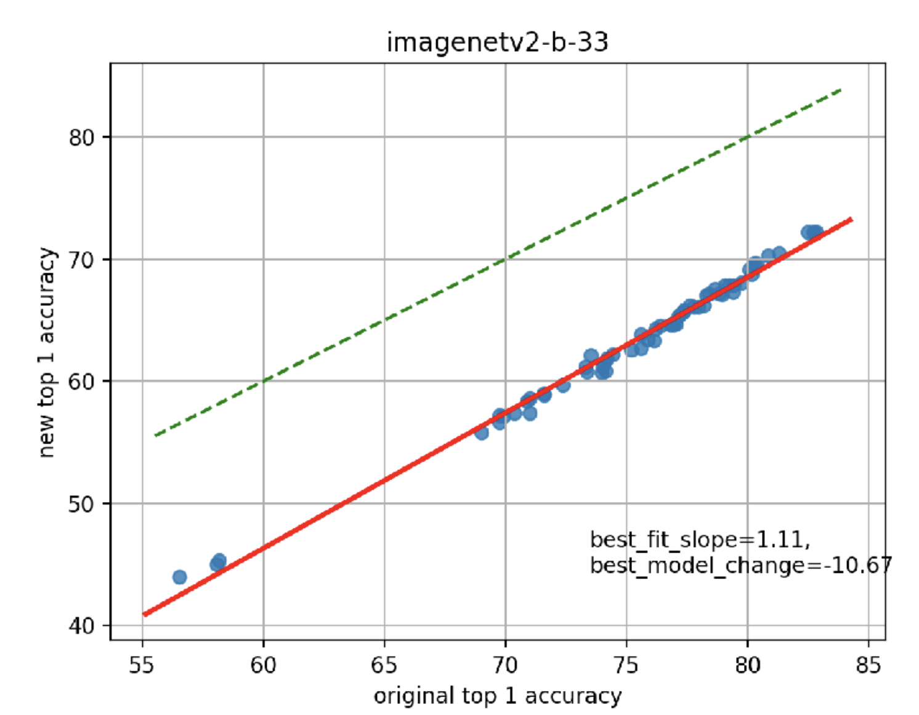
Slides from Ben Recht

Slide 17
Conclusions of this study
Relative ranking of models mostly preserved even under new test sets.
There does not appear to be a high degree of overfitting since ranking is preserved.
Accuracy drop due to harder examples (not enough training instances of such examples)
So many unanswered questions
Subtle forms of overfitting?
Annotation noise
Robustness to variations

Slide 18
Theoretical explanation for this?
Slides from Ben Recht

Slide 19
Theory for Modern NN
From Belkin etal, “Reconciling modern machine learning and the bias-variance trade-off”

Slide 20
Setup
Random Fourier features(RFF); The hypothesis class;
$$h\left(x\right)=\sum_{k=1}^{N}{a_{k}φ\left(x,ν_{k}\right)} ; φ\left(x,ν\right)≔e^{\sqrt{−1}x^{⊤}ν}$$
where $ν_{k}$ are i.i.d. samples from a normal dist.
This is similar to the two layer NN, except that basis is fixed

Slide 21
Model Norm (RFF)
Double descent
Statistics vs Approximation
Norm found by SGD
Test loss keeps going down
Even train loss not changing

Slide 22
Kernel Machine Result
$h^{∗}∈ℋ_{∞}$ in realizable case
Statistical ML;
$$\sup_{h∈ℋ_{∞}}{|\hat{L}\left(h\right)−L\left(h\right)|}≤\frac{VC(d)}{N}$$
Approximation theory for ML;
$n$uniform samples form $Ω,$
For any interpolation function $h$;
$\sup_{x∈Ω}{|h\left(x\right)−h^{∗}\left(x\right)|}≤Ae^{−B{\left(\frac{N}{\log{N}}\right)}^{\frac{1}{d}}}\left(||h^{∗}||_{ℋ_{∞}}+||h||_{ℋ_{∞}}\right)$

Slide 23
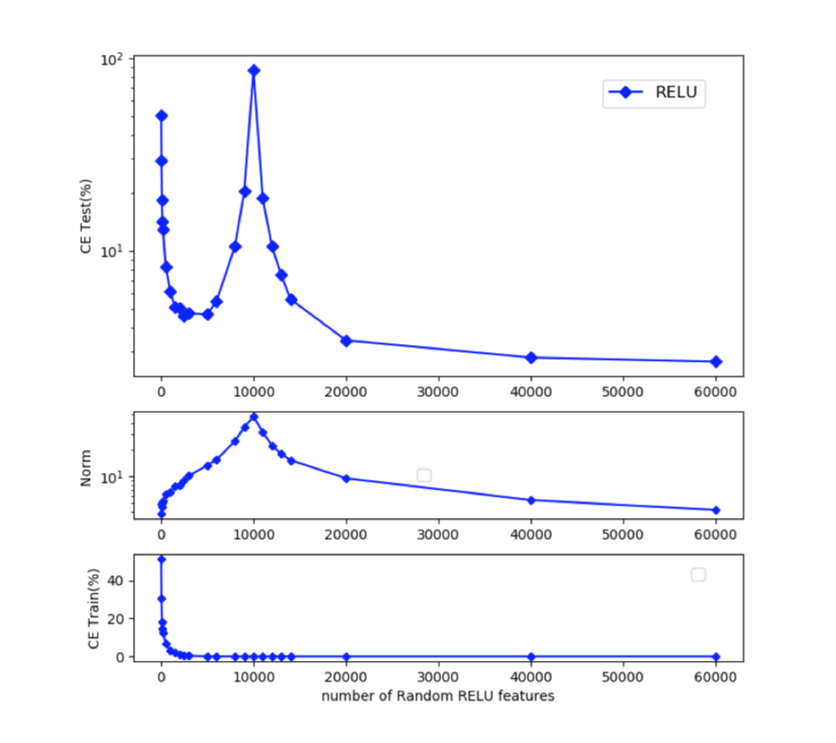
Model Norm (Random Relu)
A similar behavior
For random ReLu network

Slide 24
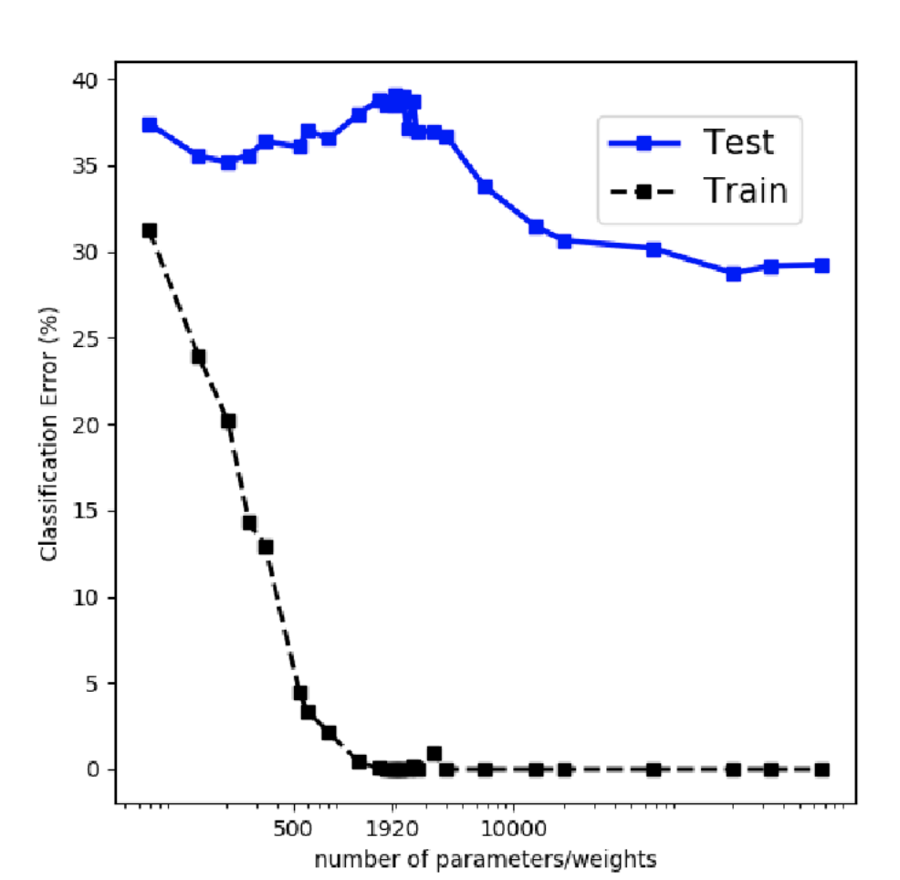
Fully connected NN
A similar behavior
CIFAR 10

Slide 25
Interpolation result
Noiseless setting : deterministic y
Favors minimum norm solution.
Not directly comparable to classical results (which allows for noise)

Slide 26
What about optimization?
Gradient descent (no stochasticity)
Fully connected networks, ConvNets and Resnets
Width of each layer exponentially large in number of layers for fully connected but polynomial for ConvNets and Resnets (but requires overparameterization in each layer)
Learning rate exponentially small in number of layers for fully connected but polynomial for ConvNets and Resnets

Slide 27
So what is the cost?
Slides from Ben Recht

Slide 28
Huge compute requirements
Slides from Ben Recht

Slide 29
Huge compute requirements
Slides from Ben Recht

Slide 30
Is this a good summary?
Slides from Ben Recht

Slide 31
Next Lecture..
Slides from Zico Kolter

