Slide 1
CMS 165
Lecture 14
Tackling Data Scarcity
Active Learning

Slide 2
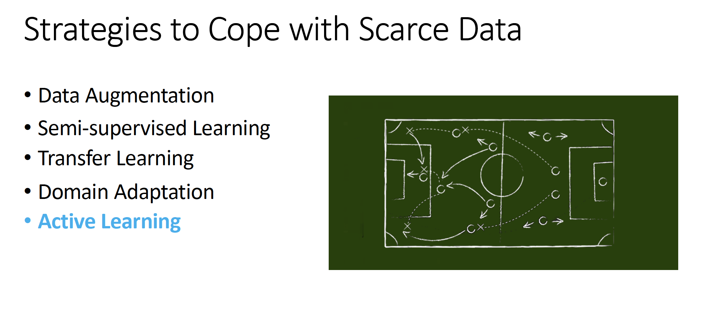
Slides from Zack Lipton

Slide 3
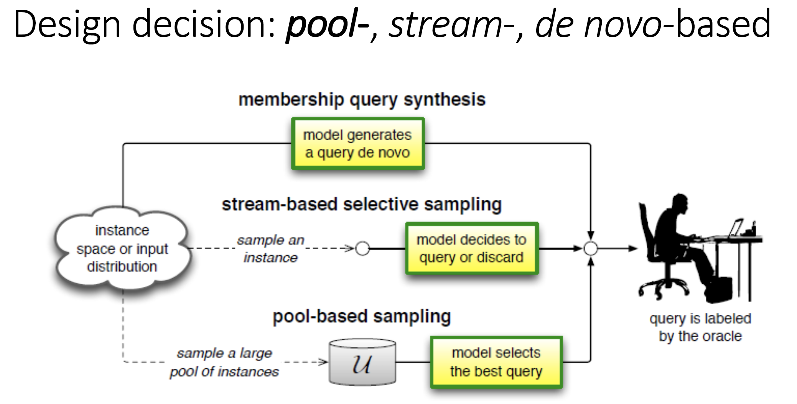

Slide 4
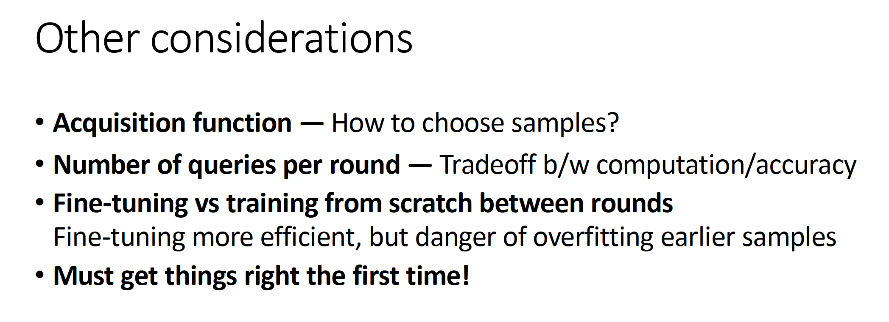
Slides from Zack Lipton

Slide 5
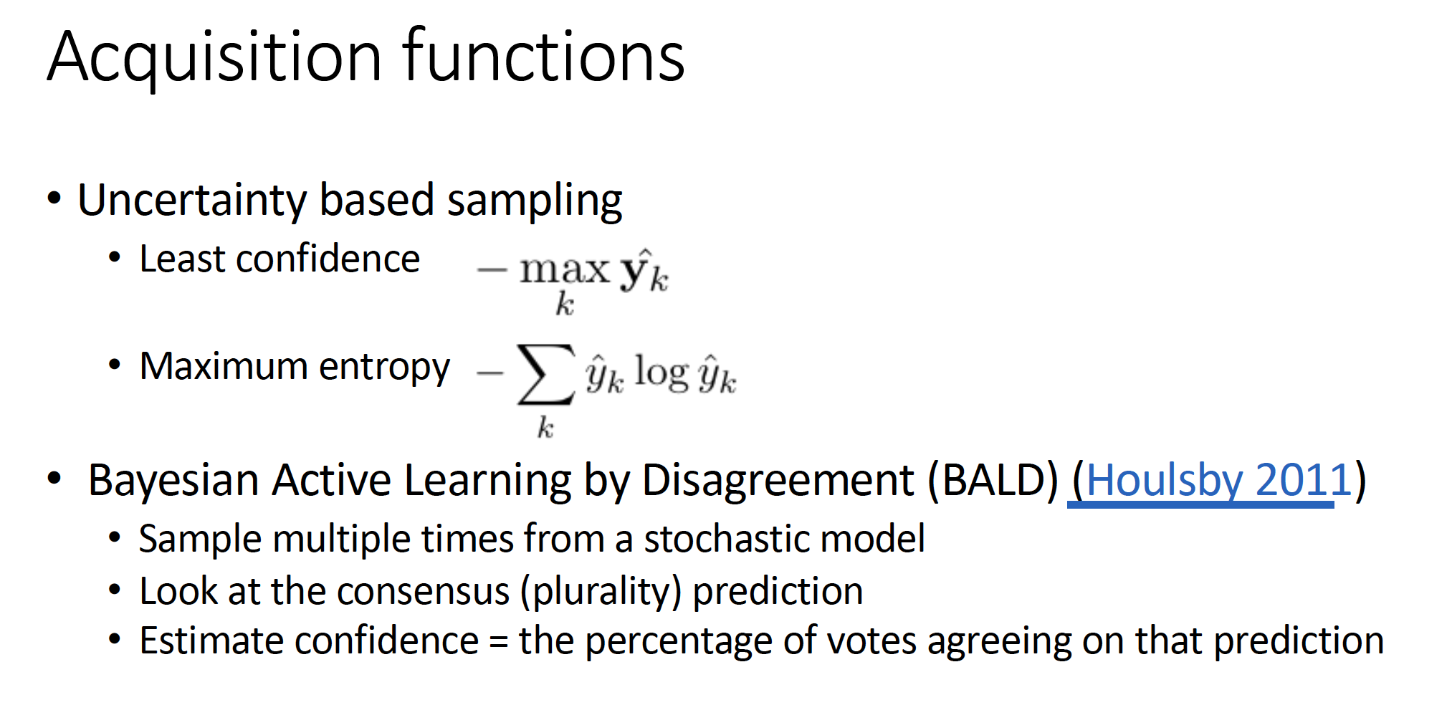
Slides from Zack Lipton

Slide 6
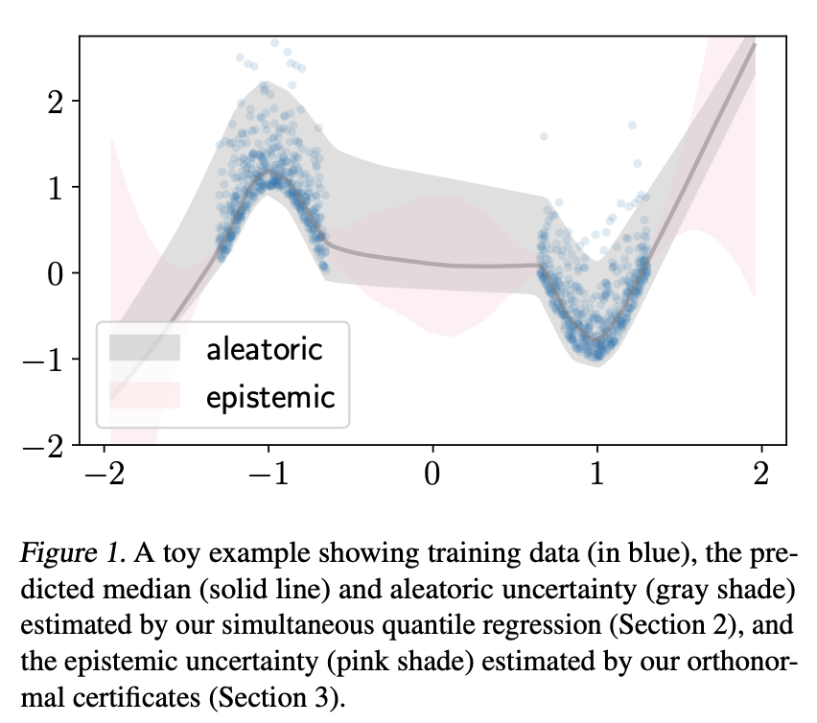
How do we measure uncertainty? And need for Bayesian models..
  Aleatoric: Not explained by data (hidden e.g. occlusions)
    Homoscedastic: uniform for all datasets
    Heteroscedastic: depends on data
  Epistemic: Uncertainty due to our model and limited data
Source: https://alexgkendall.com/computer_vision/bayesian_deep_learning_for_safe_ai/
https://arxiv.org/pdf/1811.00908.pdf

Slide 7
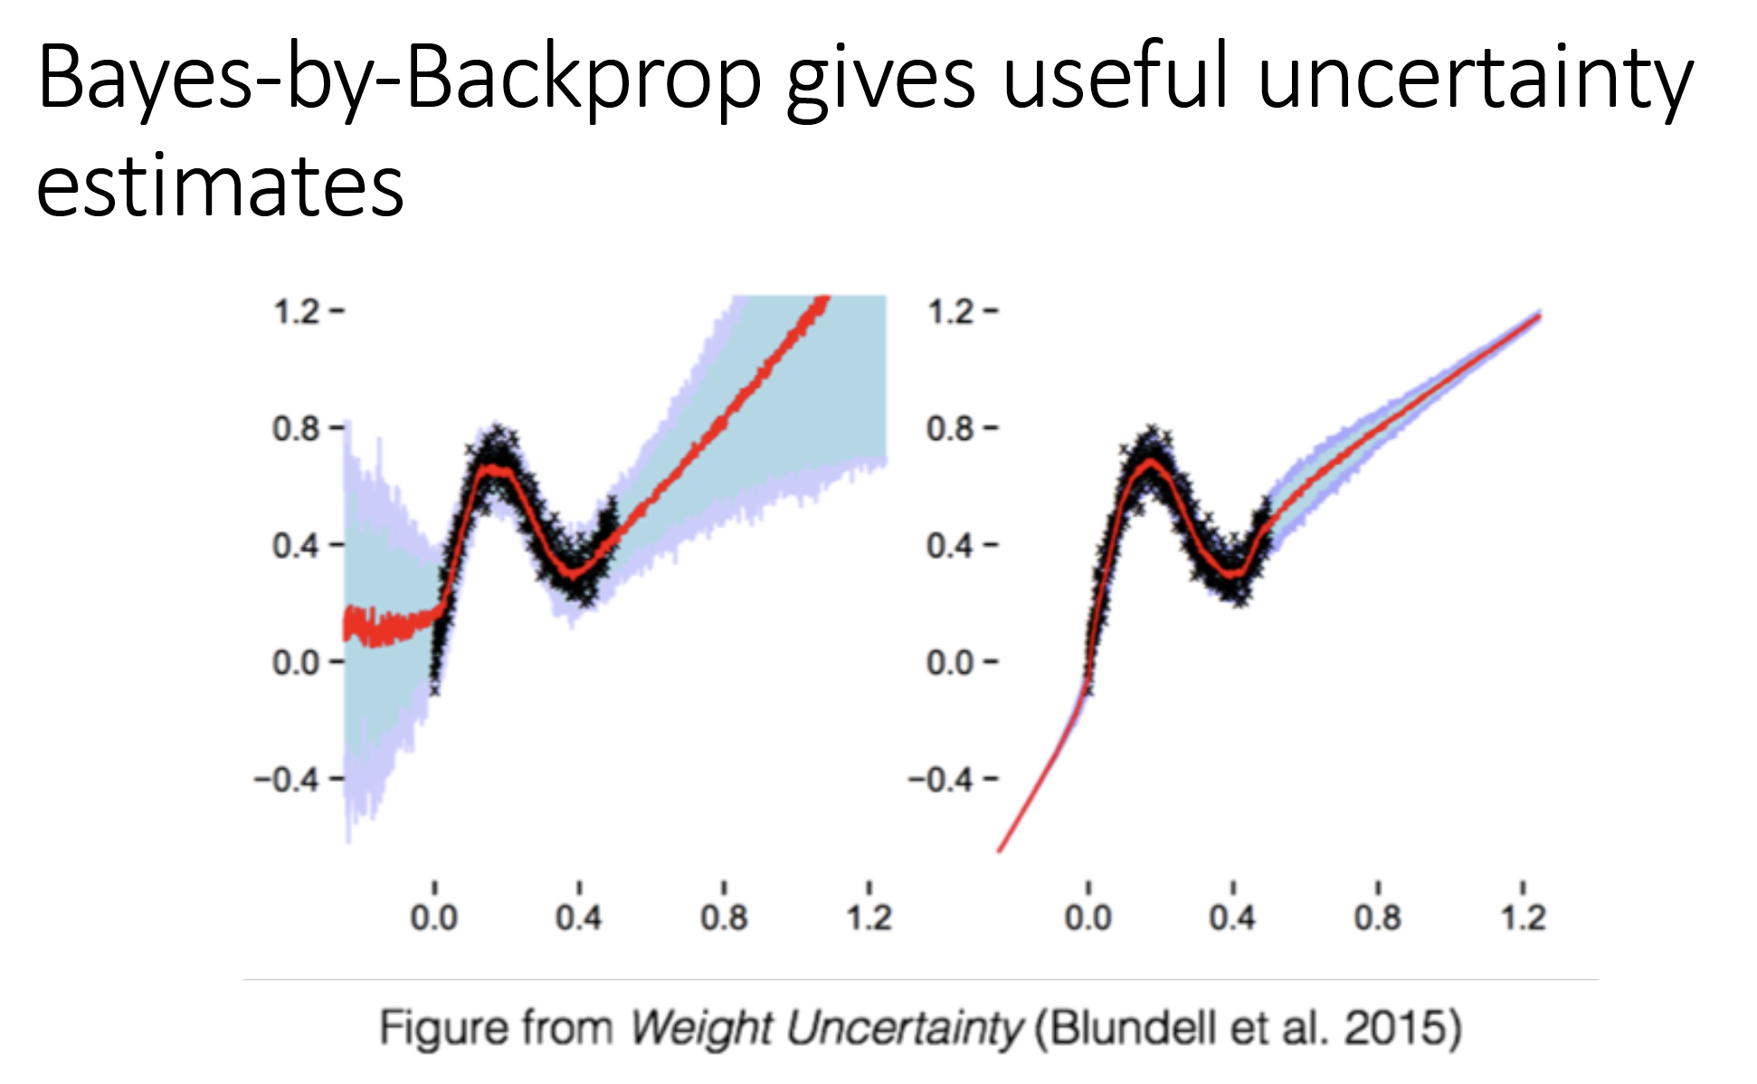
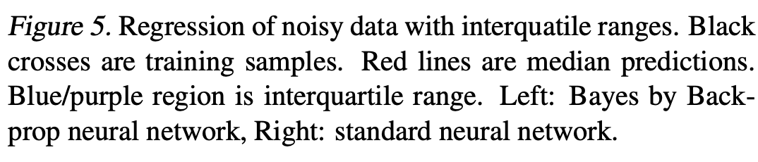
Standard (frequentist) neural networks are poorly calibrated and don’t model epistemic uncertainty well
DNN tend to be overconfident and suffer from unknown unknowns:
they do not know that they are making errors

Slide 8
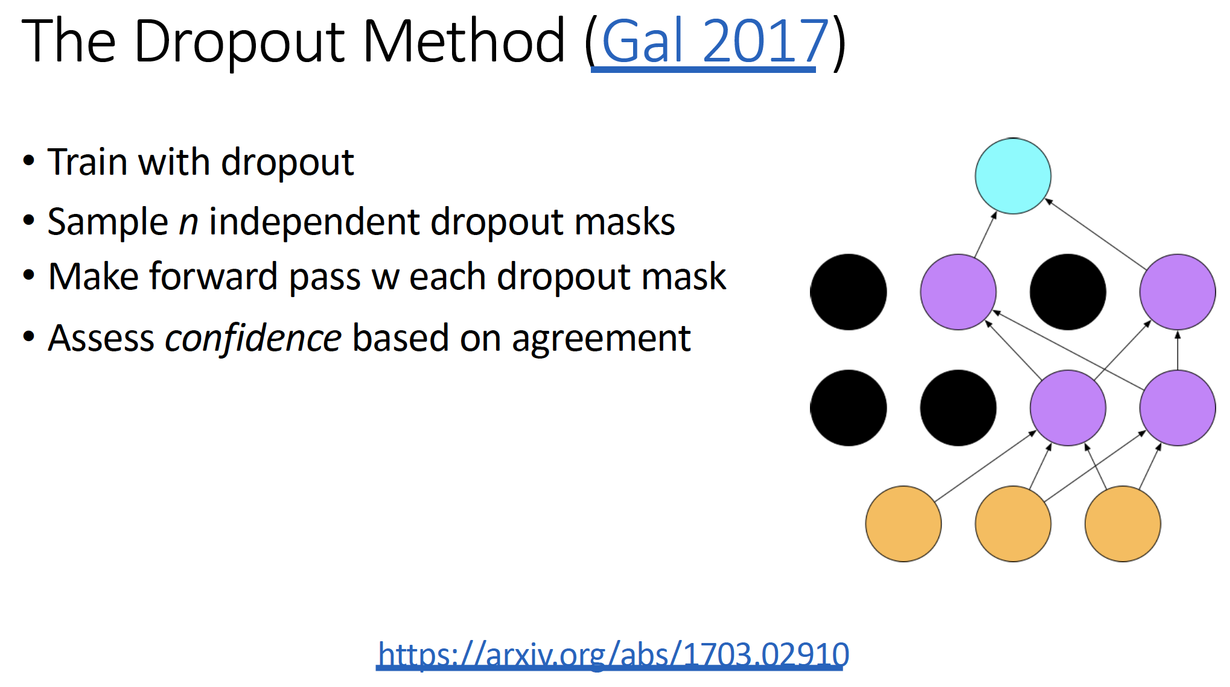
How to obtain Bayesian uncertainty (cheaply)
Slides from Zack Lipton

Slide 9
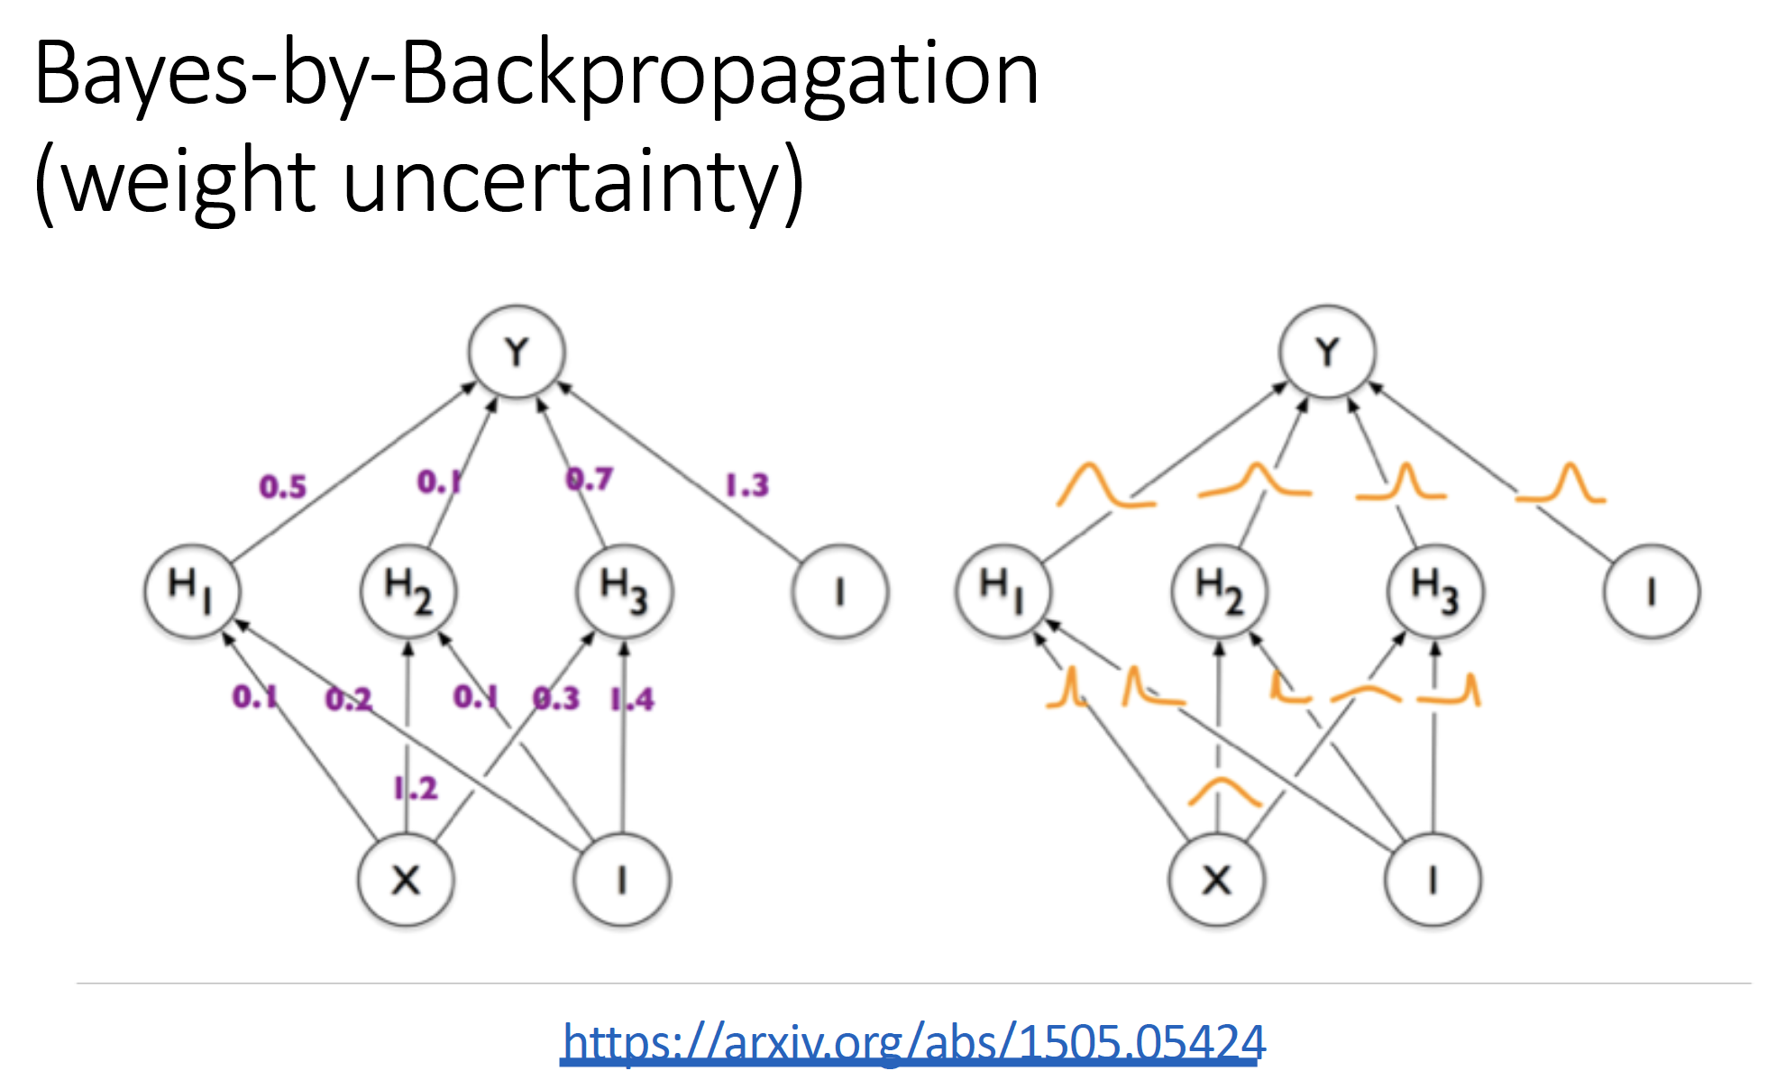
How to obtain Bayesian uncertainty (cheaply)
Slides from Zack Lipton

Slide 10
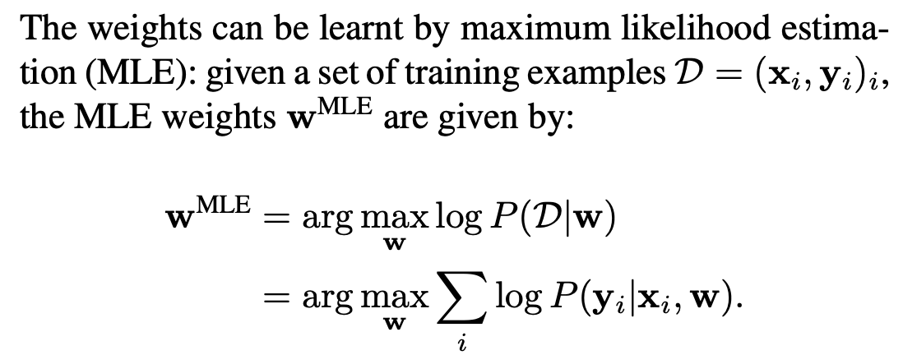
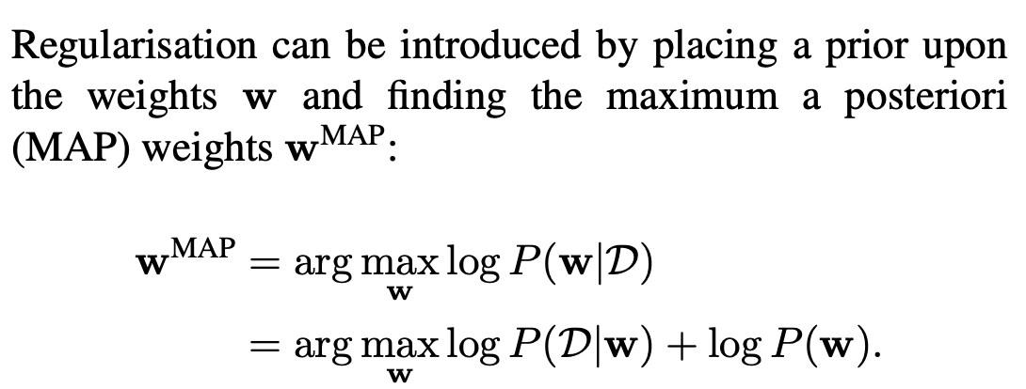
Bayes by Backprop Principle
Catch: computational bottleneck
Computing posterior: sampling over infinite ensemble of neural networks
Not scalable even for moderate networks
Alternative: variational approximation to approximate the posterior
From Blundell et al..

Slide 11
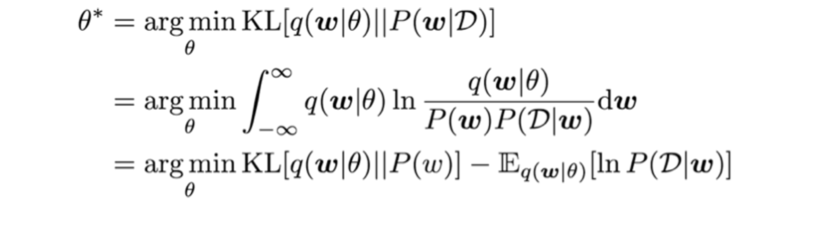
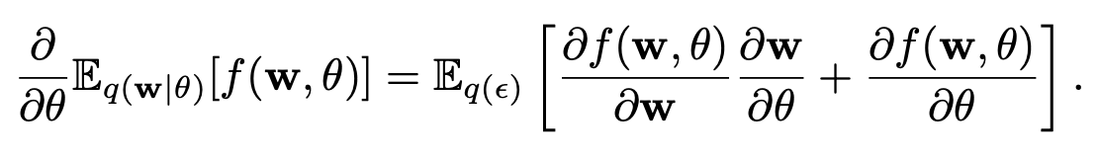
How to obtain Bayesian uncertainty (cheaply)
Various approximations to solve this optimization problem.
Use gradients instead of exact minimization..
From Blundell et al..

Slide 12
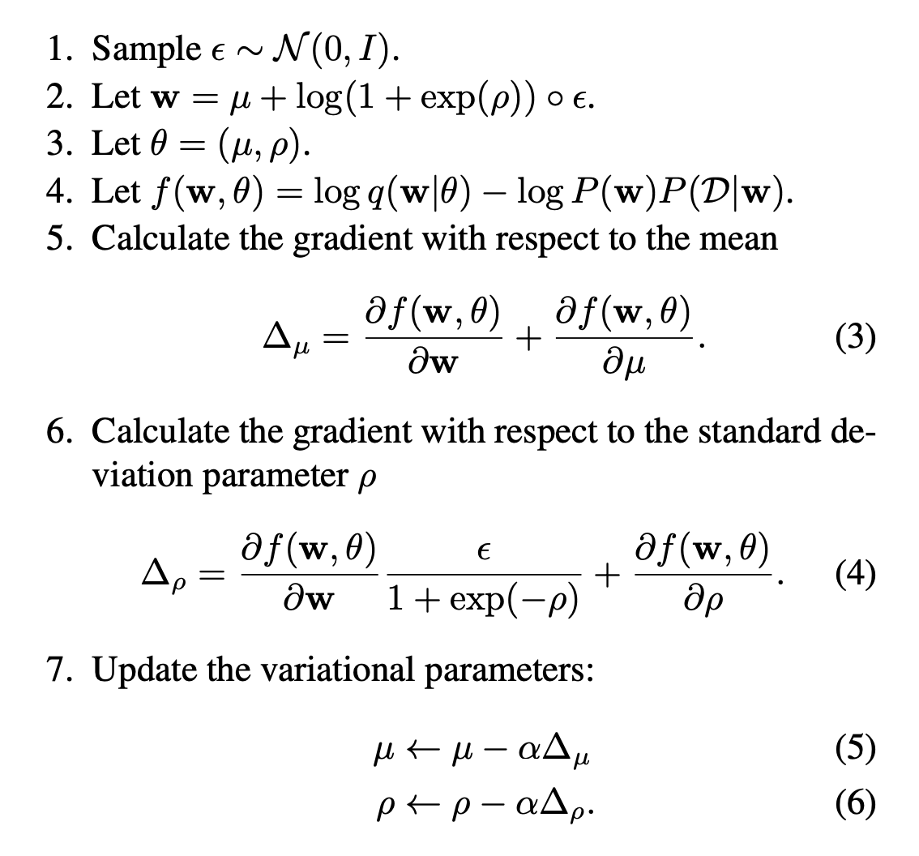
Variational approximation with Gaussian Dist.
Popular choice: variational posterior is a diagonal Gaussian
From Blundell et al..

Slide 13
How to obtain Bayesian uncertainty (cheaply)
Slides from Zack Lipton

Slide 14
Slides from Zack Lipton

Slide 15
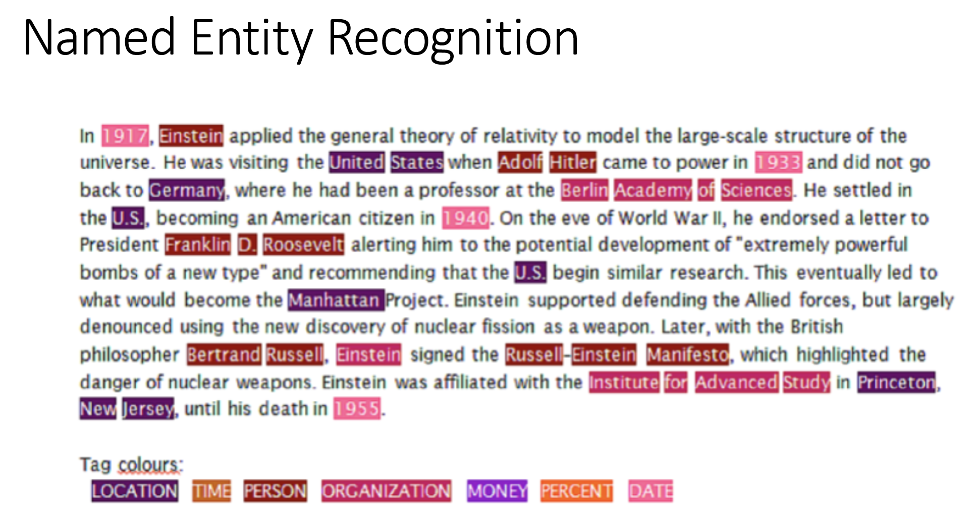
Slides from Zack Lipton

Slide 16
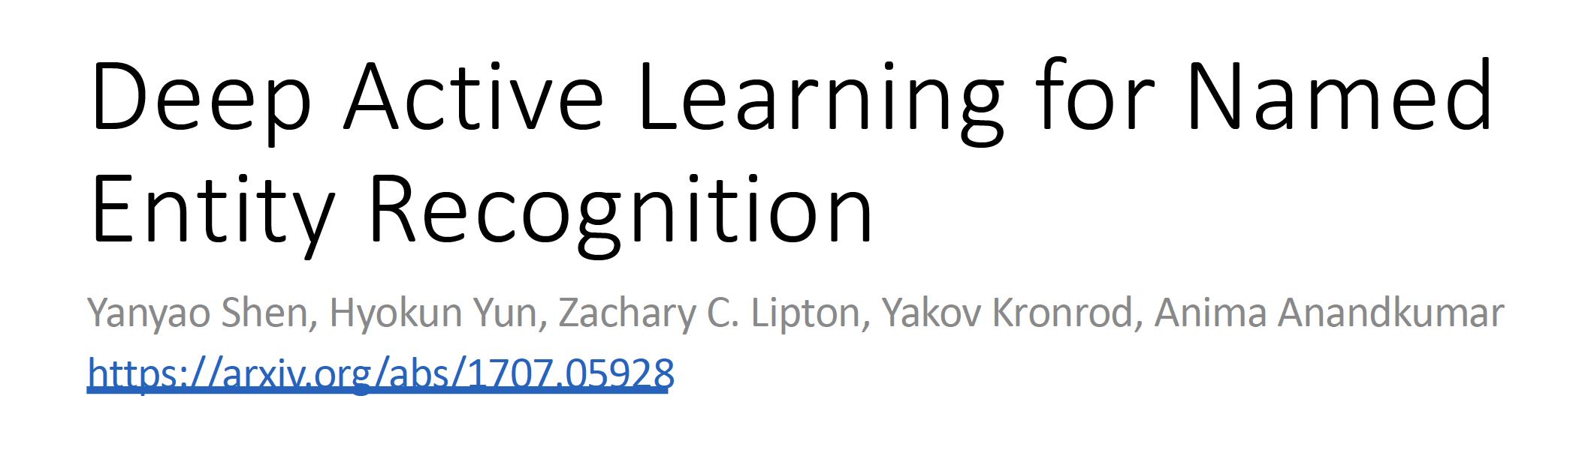

Slide 17
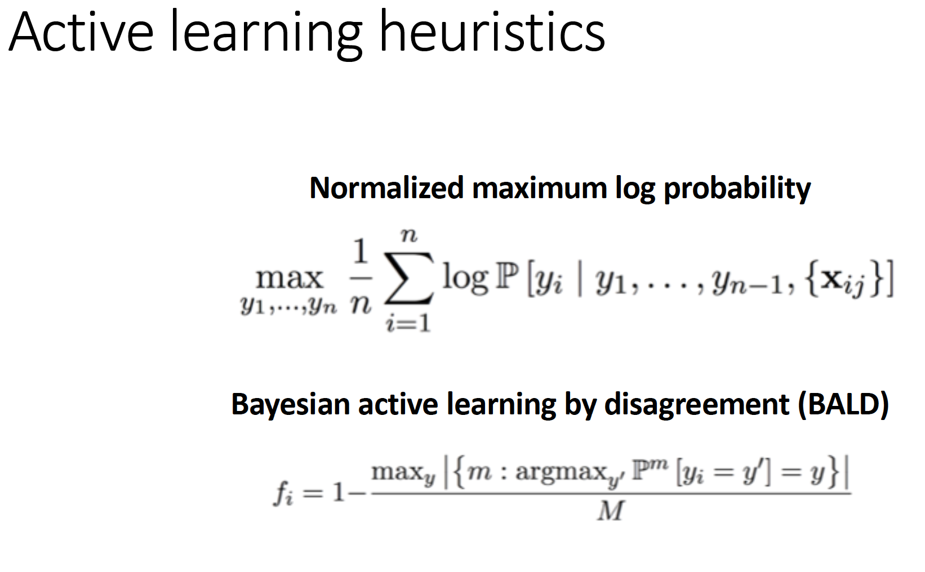
Slides from Zack Lipton

Slide 18
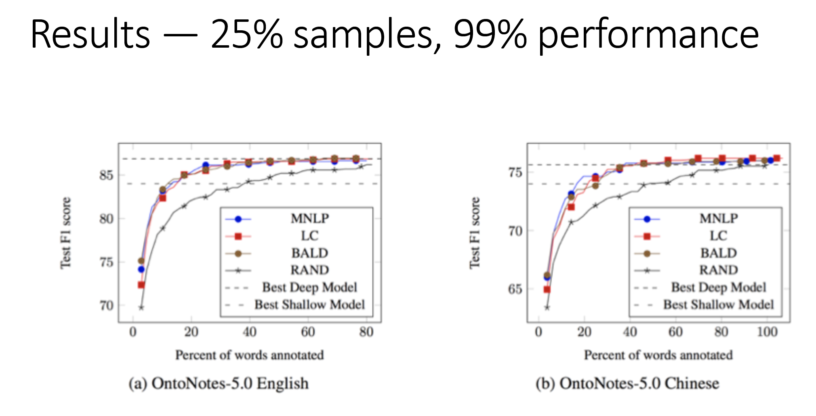
Slides from Zack Lipton

Slide 19
Take-aways
Uncertainty sampling works. Normalizing for length helps under low data.
With active learning, deep beats shallow even in low data regime.
With active learning, SOTA achieved with far fewer samples.

Slide 20
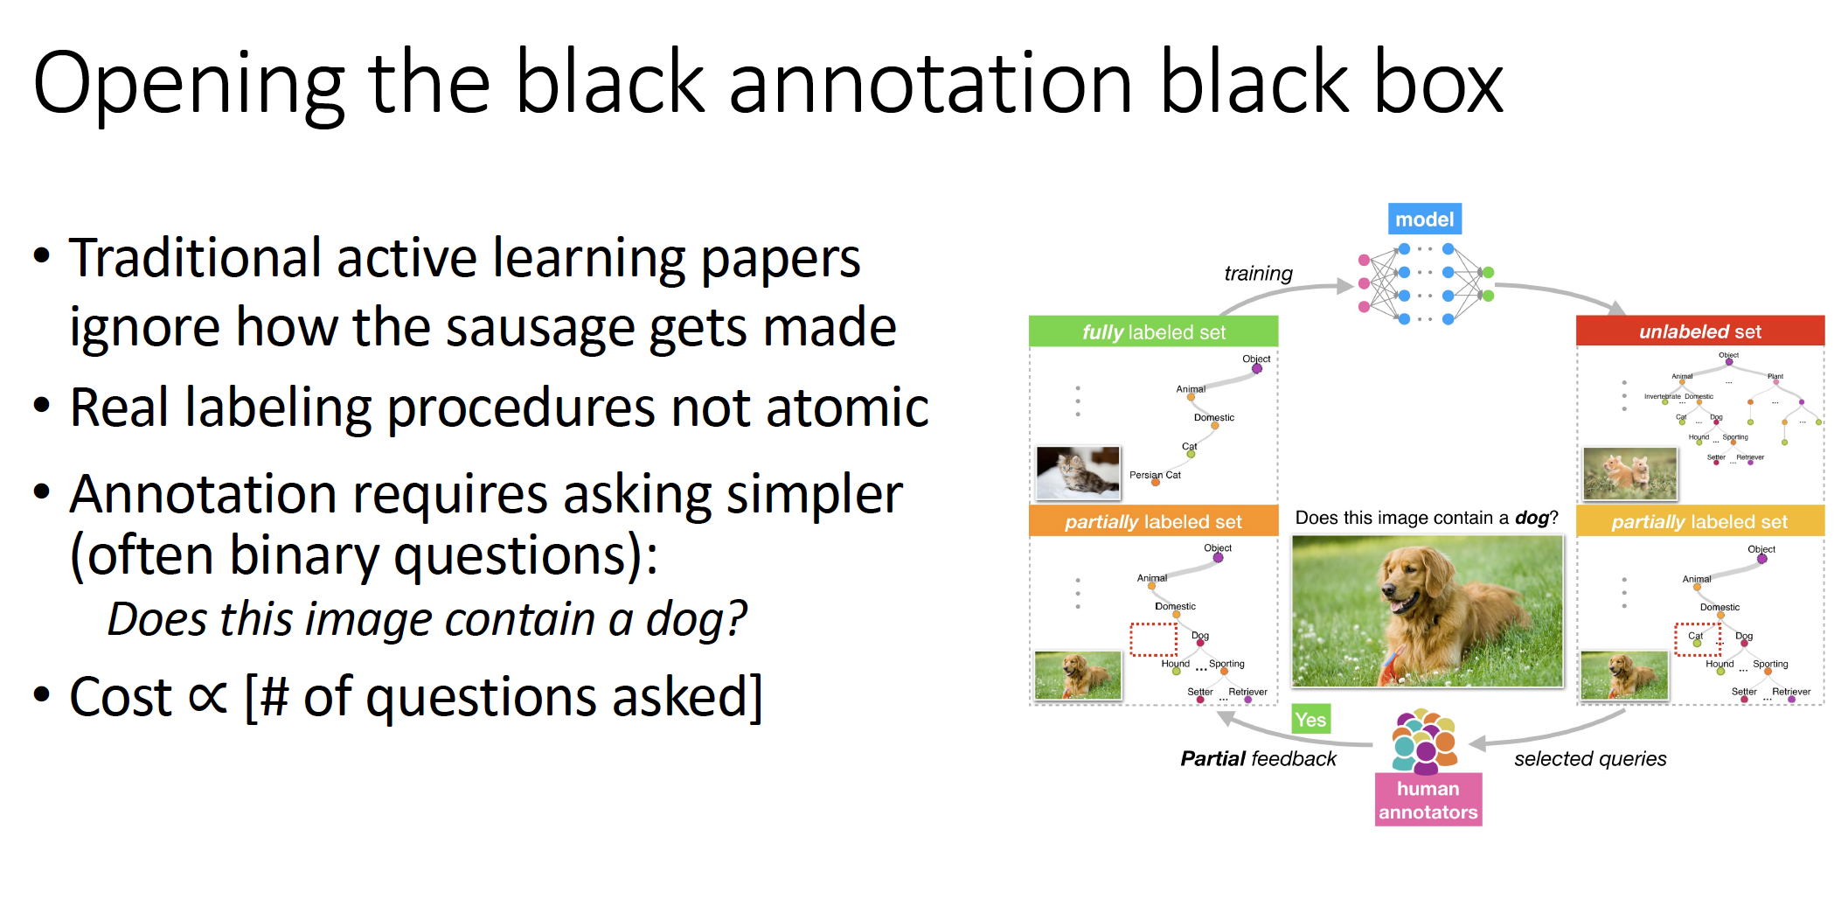
Slides from Zack Lipton

Slide 21
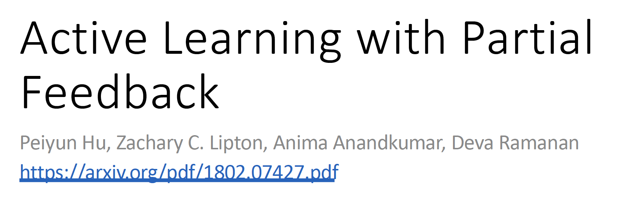

Slide 22
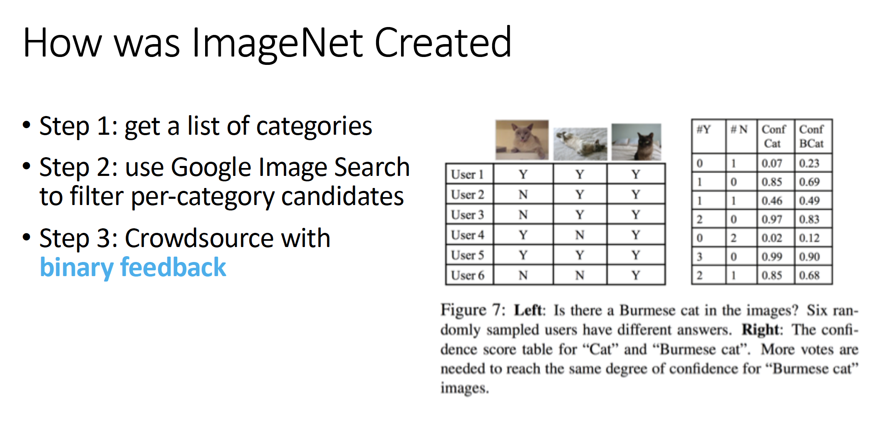
Slides from Zack Lipton

Slide 23
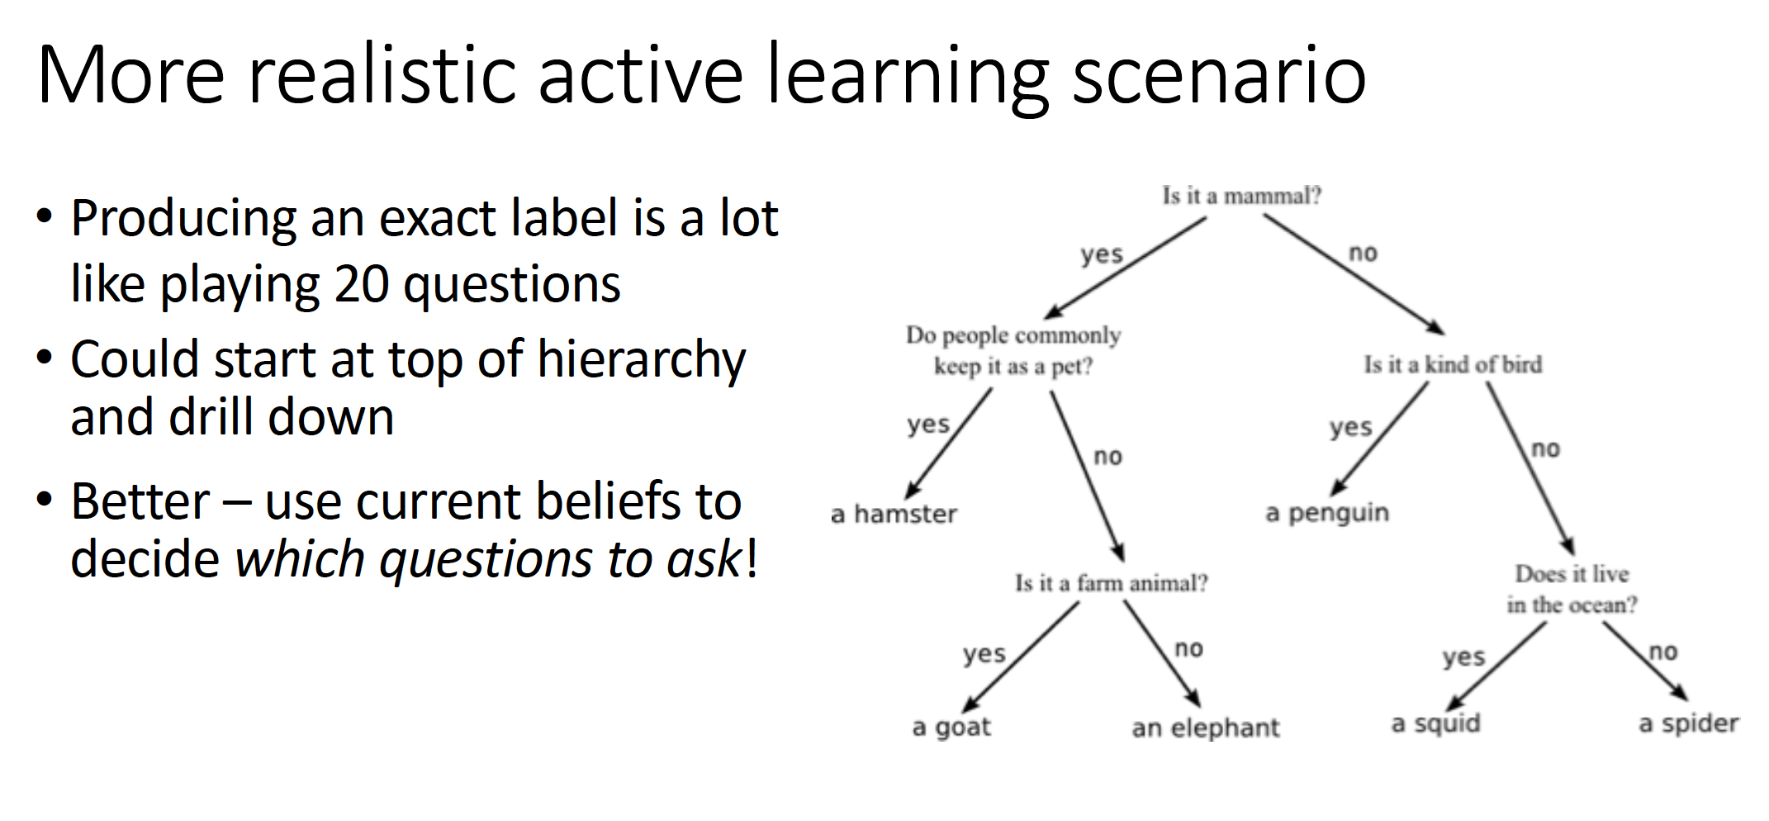
Slides from Zack Lipton

Slide 24
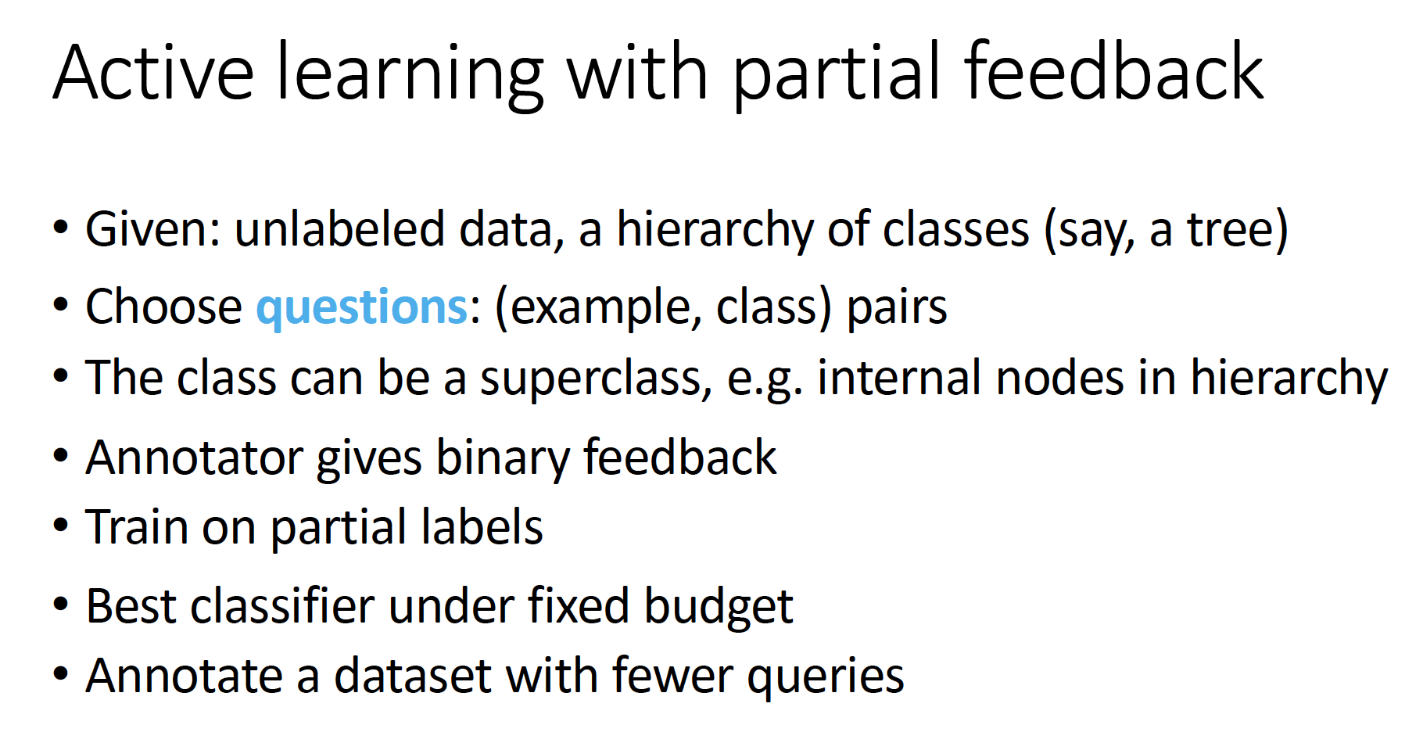
Slides from Zack Lipton

Slide 25
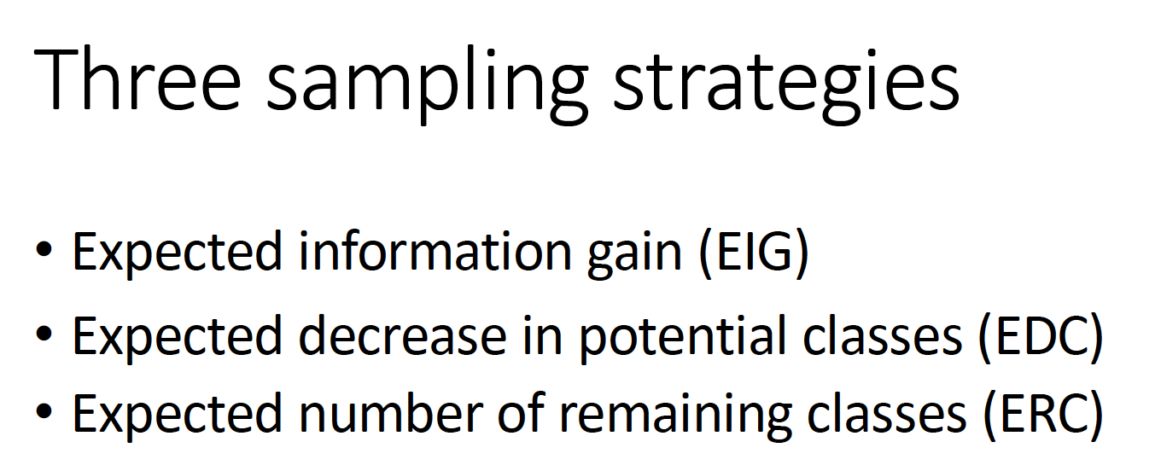
ERC performed the best
Slides from Zack Lipton

Slide 26
results on Tiny ImageNet (100k samples)
ALPF-ERC
active data
active questions
Uniform
inactive data
inactive questions
AQ-ERC
inactive data
active questions
AL-ME
active data
inactive questions
Yield 8% higher accuracy at 30% questions (w.r.t. Uniform)
Obtain full annotation with 40% less binary questions

Slide 27
Two take-aways
Don’t annotate from scratch
  Select questions actively based on the learned model
Don’t sleep on partial labels
  Re-train model from partial labels

Slide 28
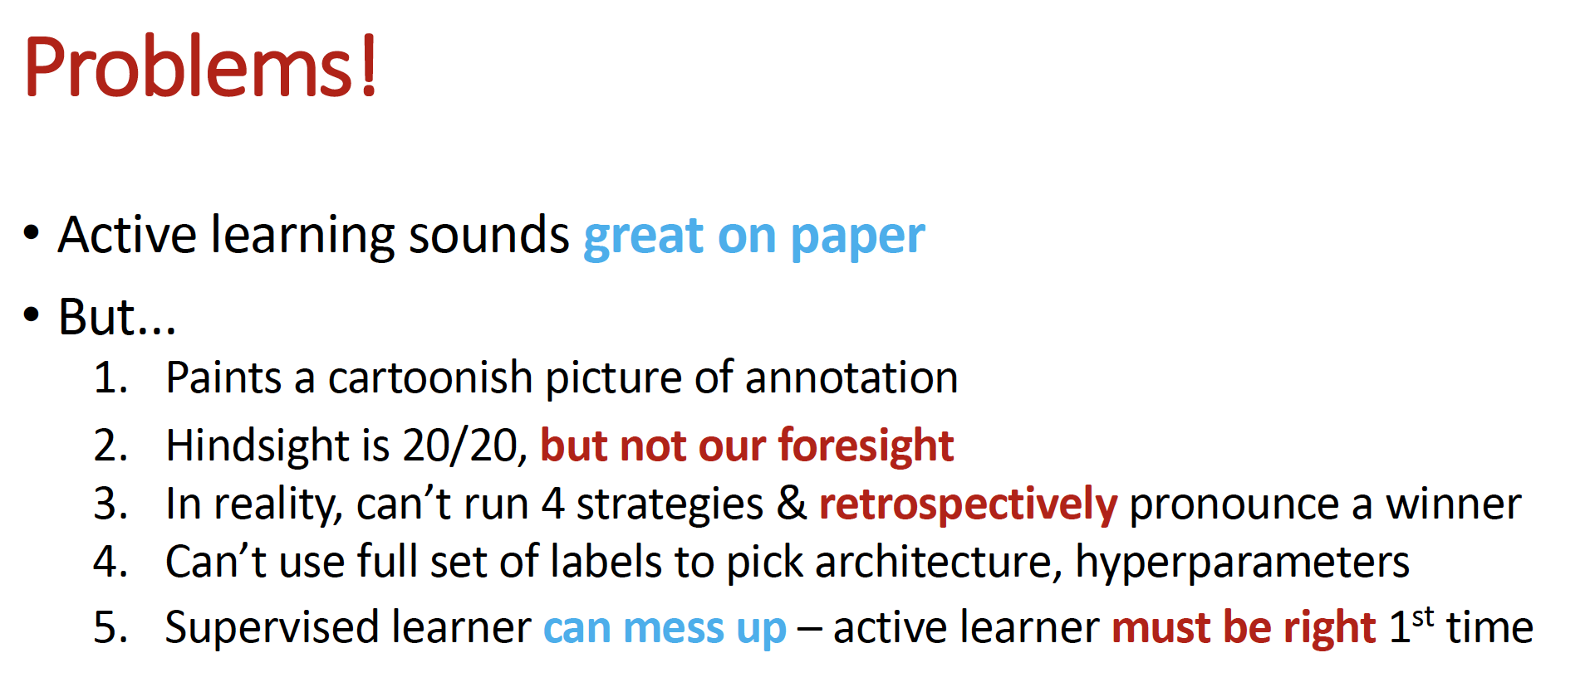
Slides from Zack Lipton

Slide 29
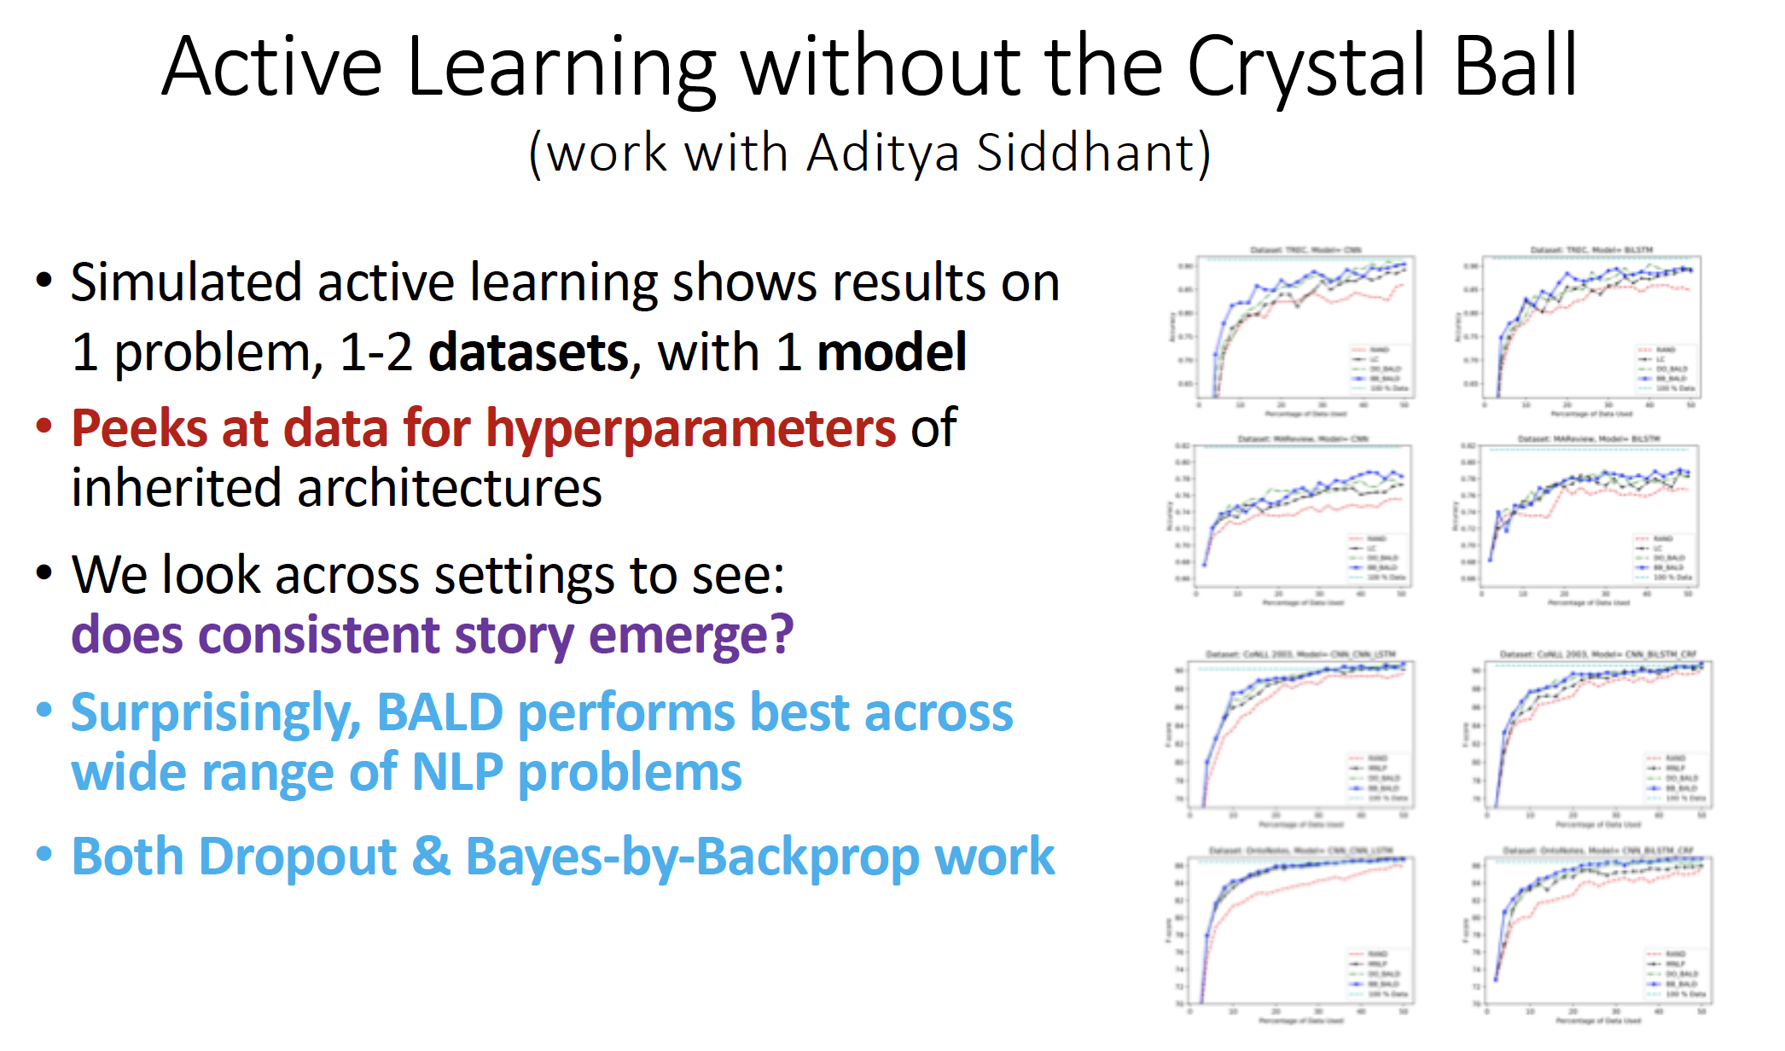
Slides from Zack Lipton

Slide 30
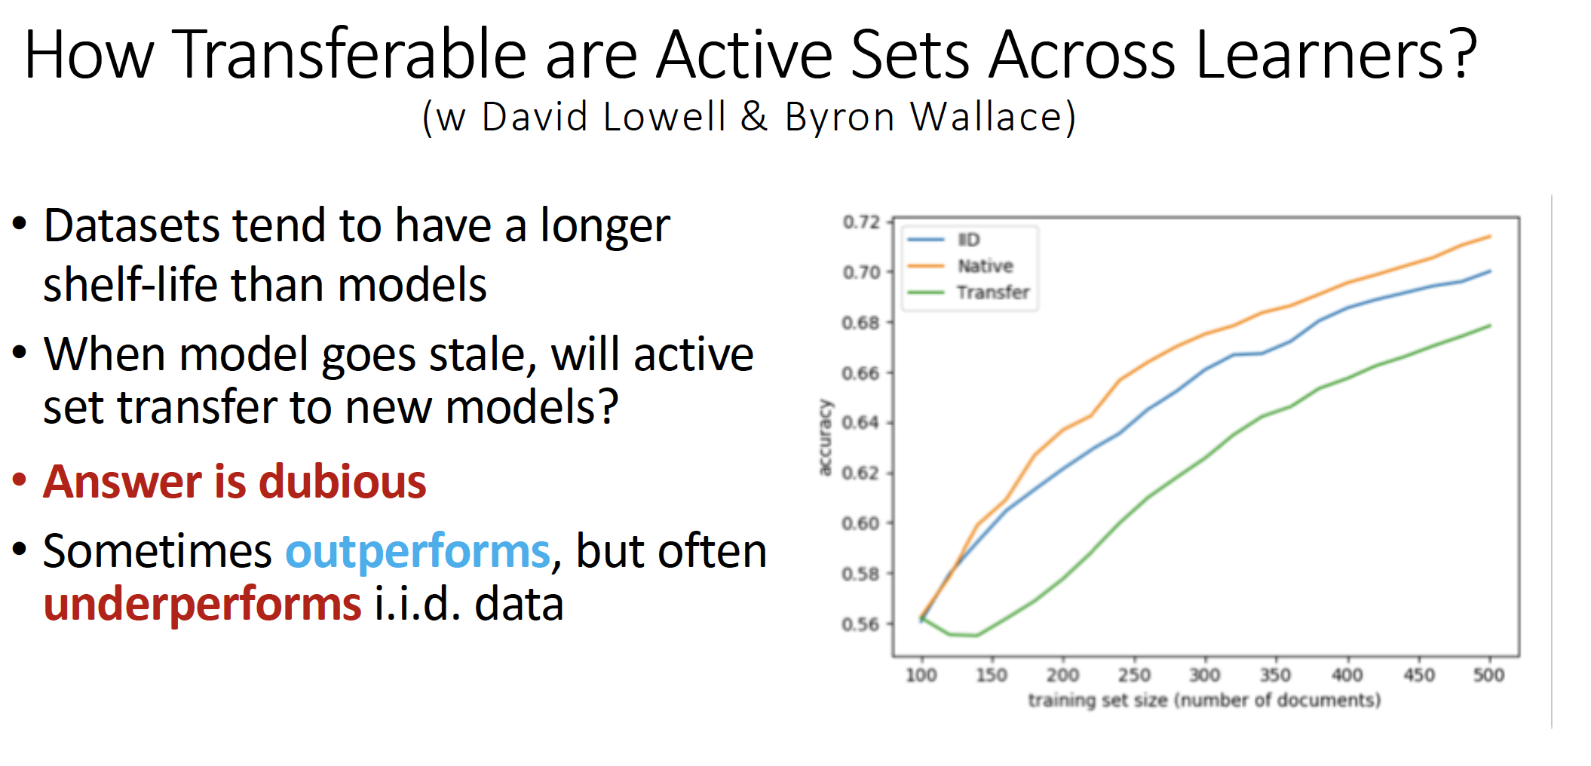
GET MORE INFO this
Slides from Zack Lipton

Slide 31
Shortcomings of uncertainty based sampling
Overfitting
  Uncertainty sampling is only exploitation and no exploration: can miss parts of sample space.
  Better alternatives: bandits, RL?
Poor calibration
  Unknown unknowns: overconfident on hard examples
Less robust to domain shifts
  Task specific: may be less transferable to other tasks

Slide 32
Data annotation issues

Slide 33
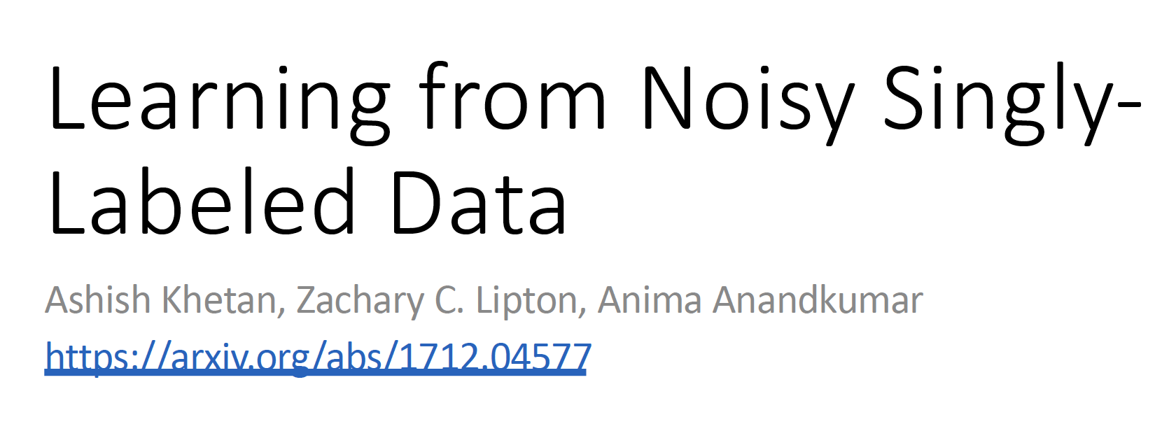

Slide 34
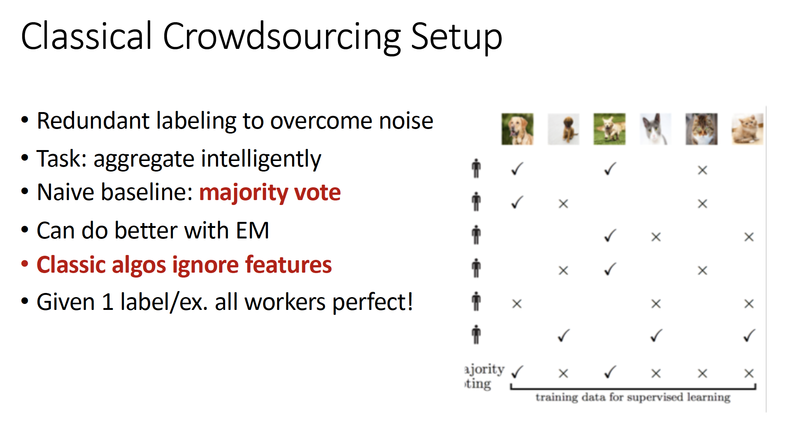

Slide 35
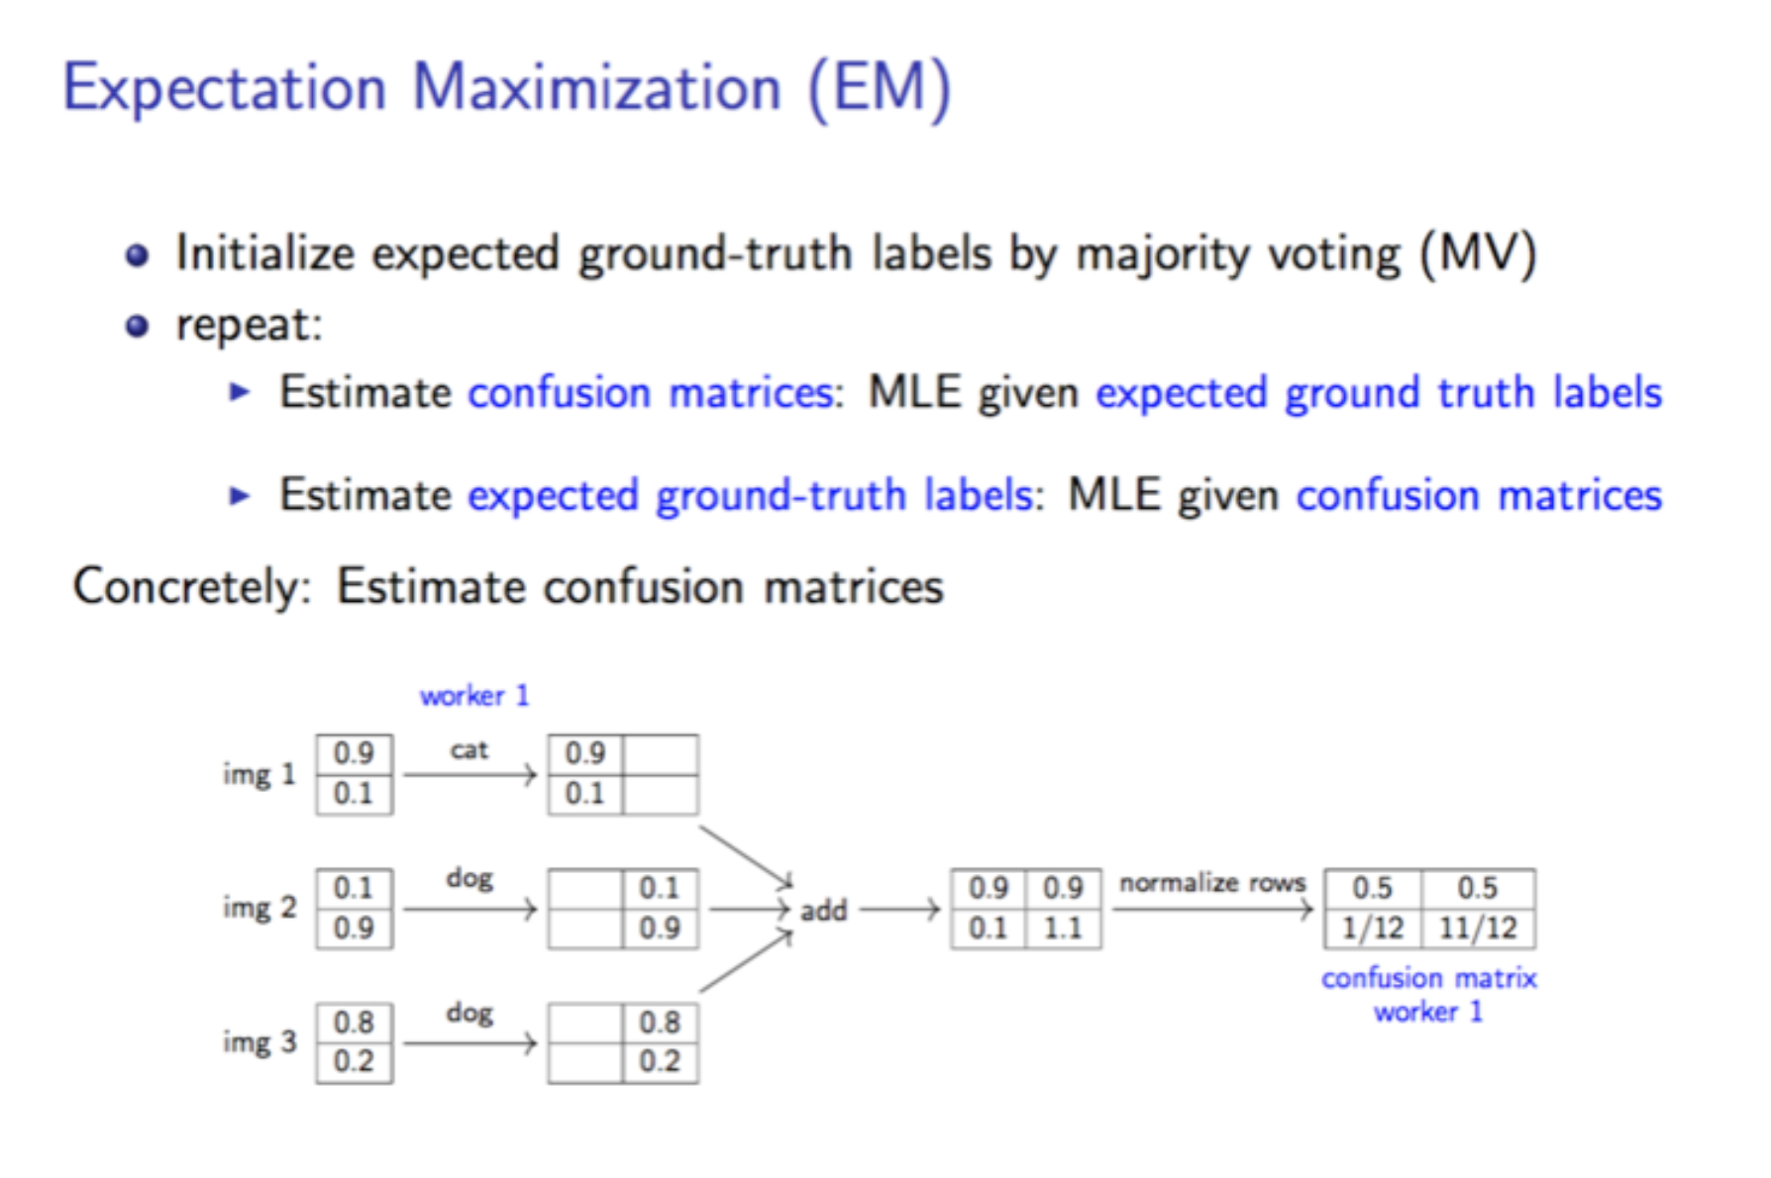

Slide 37
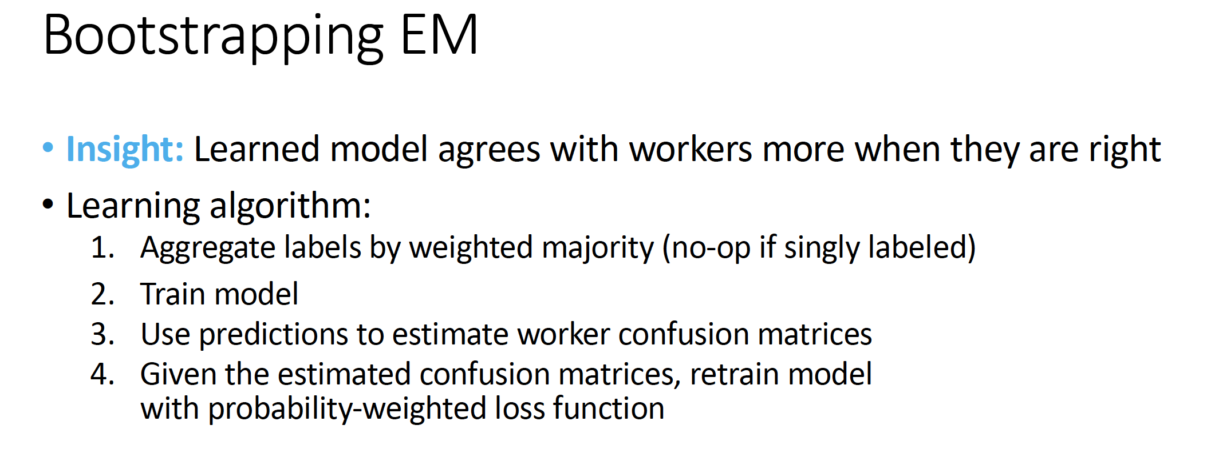

Slide 38
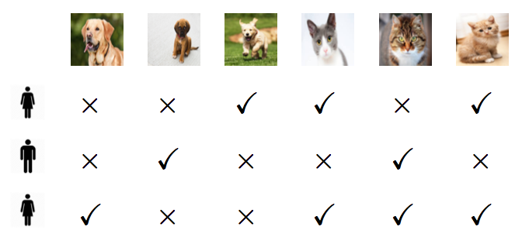

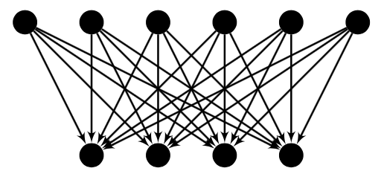
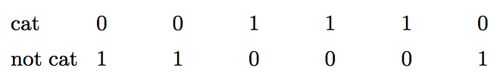
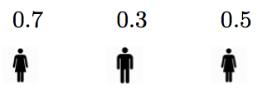
Proposed crowdsourcing algorithm
Noisy crowdsourced annotations
Repeat
Posterior of ground-truth labels given annotator quality model
Training with weighted loss.
Use posterior as weights
MLE : update Annotator quality using inferred labels from model
Use trained model to infer ground-truth labels

Slide 39
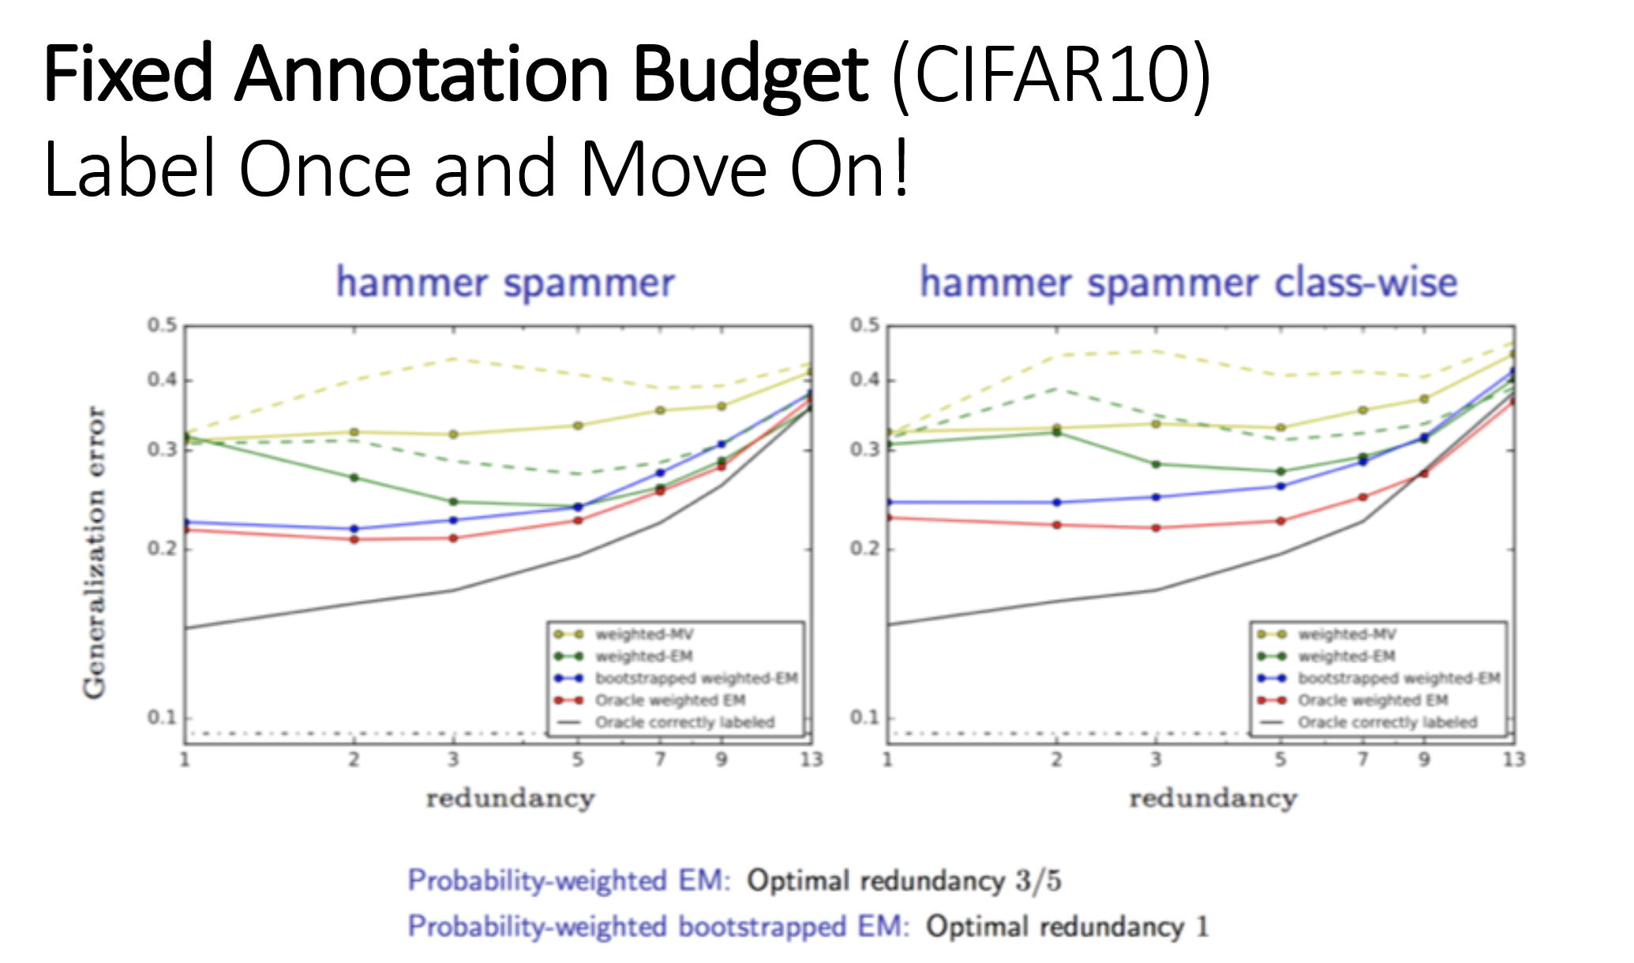

Slide 40
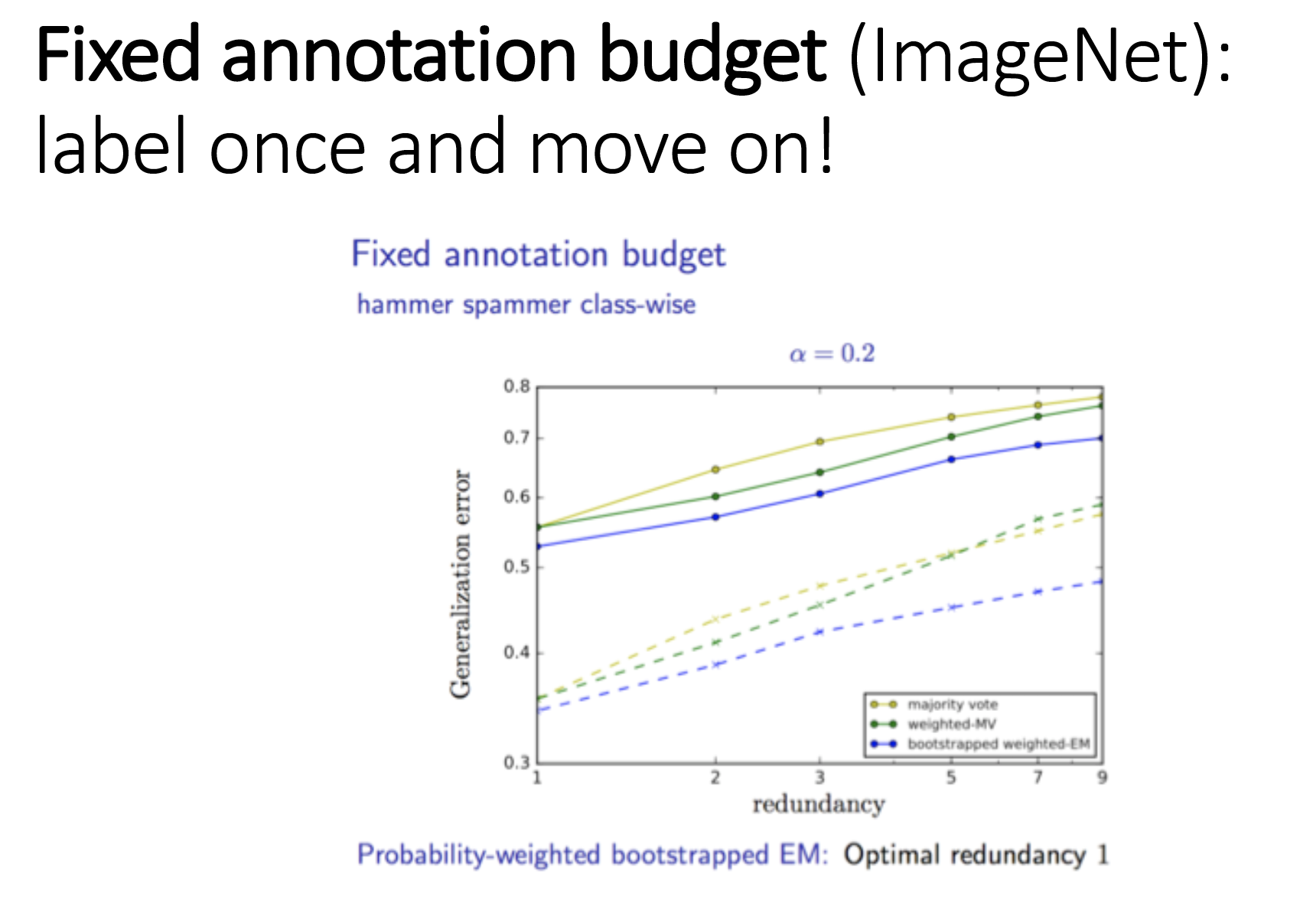

Slide 41
Labeling once is optimal: both in theory and practice
Theorem: Under fixed budget, generalization error minimized with single annotation per sample.
Assumptions:
Best predictor is accurate enough (under no label noise).
Simplified case: All workers have same quality.
Prob. of being correct > 83%
MS-COCO dataset. Fixed budget: 35k annotations
5% wrt Majority rule
F1 score
No. of workers

Slide 42
Data augmentation
To improve generalization, augment training data.
In computer vision. Simple techniques: rotation, cropping, noise
In speech recognition: Additive background noise and spectral transform
More sophisticated approaches ?
Notes:
Currently only simple augmentation techniques employed.

