Slide 1
CMS 165
Lecture 8
Approximation and Generalization in
Neural Networks

Slide 2

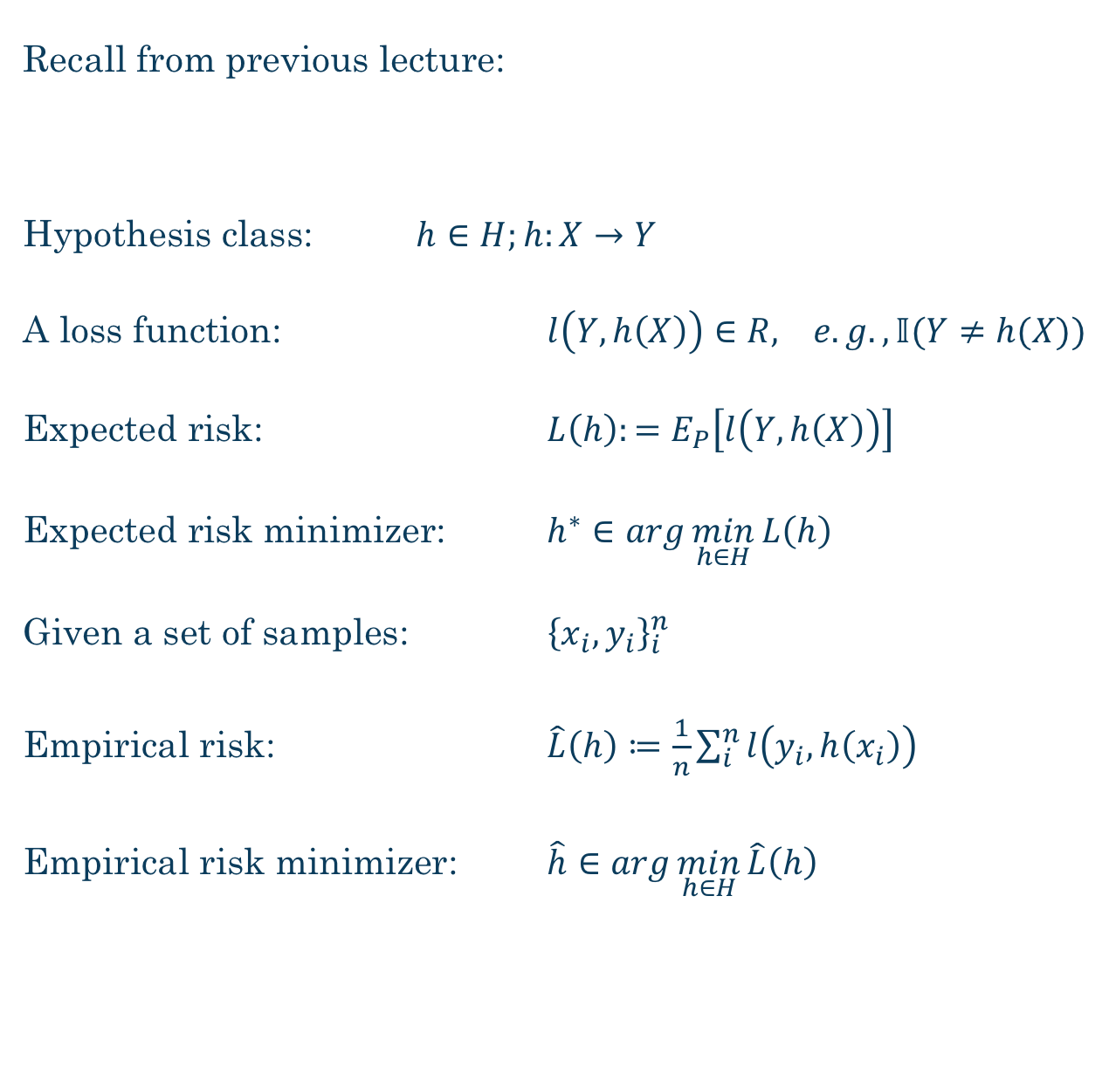

Recall from previous lecture:
Hypothesis class: $h∈H;h:X→Y$
A loss function: $l\left(Y,h\left(X\right)\right)∈R, e.g., 𝕀(Y≠h(X))$
Expected risk: $L\left(h\right):=E_{P}\left[l\left(Y,h\left(X\right)\right)\right]$
Expected risk minimizer: $h^{∗}∈\arg{\min_{h∈H}{L\left(h\right)}}$
Given a set of samples: ${\left\{x_{i},y_{i}\right\}}_{i}^{n}$
Empirical risk: $\hat{L}\left(h\right)≔\frac{1}{n}\sum_{i}^{n}{l\left(y_{i},h\left(x_{i}\right)\right)}$
Empirical risk minimizer: $\hat{h}∈\arg{\min_{h∈H}{\hat{L}\left(h\right)}}$
$$P$$
$$X,Y∼P$$

Slide 3
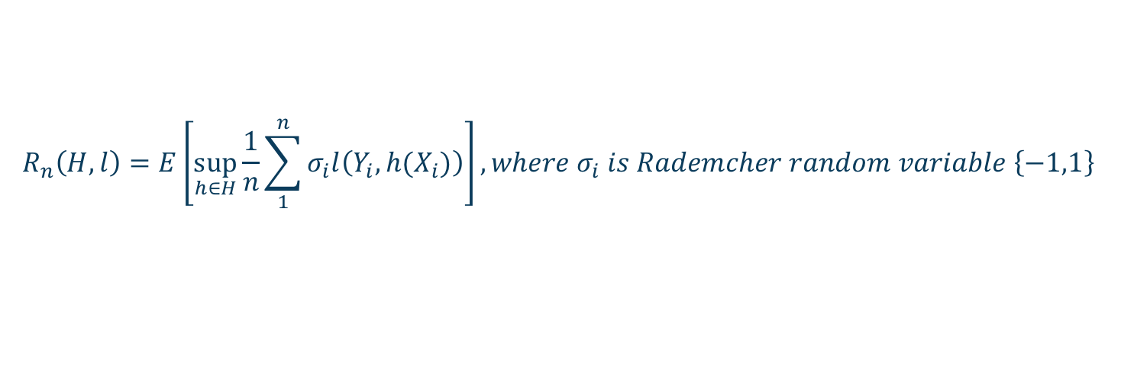
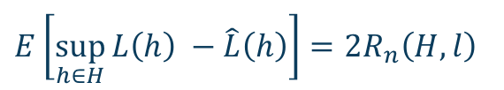
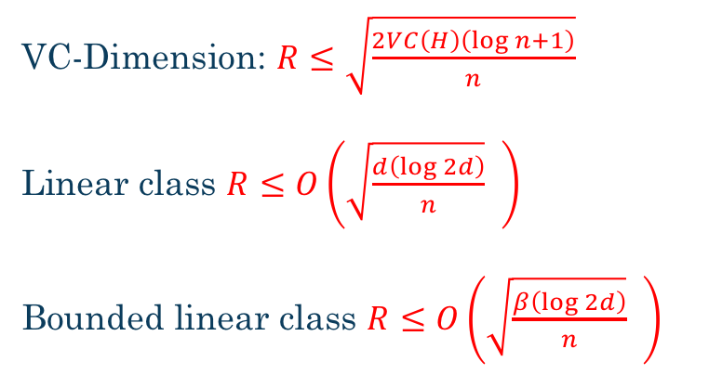
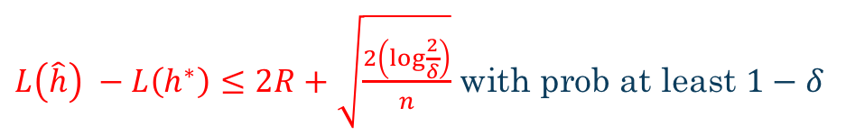
Measures of Complexity
$E\left[\sup_{h∈H}{L\left(h\right) −\hat{L}\left(h\right)}\right]=2R_{n}\left(H,l\right)$
$$R_{n}\left(H,l\right)=E\left[\sup_{h∈H}{\frac{1}{n}\sum_{1}^{n}{σ_{i}l\left(Y_{i},h(X_{i})\right)}}\right], where σ_{i} is Rademcher random variable \left\{−1,1\right\}$$
$L\left(\hat{h}\right) −L\left(h^{∗}\right)≤2R+\sqrt{\frac{2\left(\log{\frac{2}{δ}}\right)}{n}}$ with prob at least $1−δ$
VC-Dimension: $R≤\sqrt{\frac{2VC\left(H\right)\left(\log{n}+1\right)}{n}}$
Linear class $R≤O\left(\sqrt{\frac{d\left(\log{2d}\right)}{n}} \right)$
Bounded linear class $R≤O\left(\sqrt{\frac{β\left(\log{2d}\right)}{n}} \right)$

Slide 4
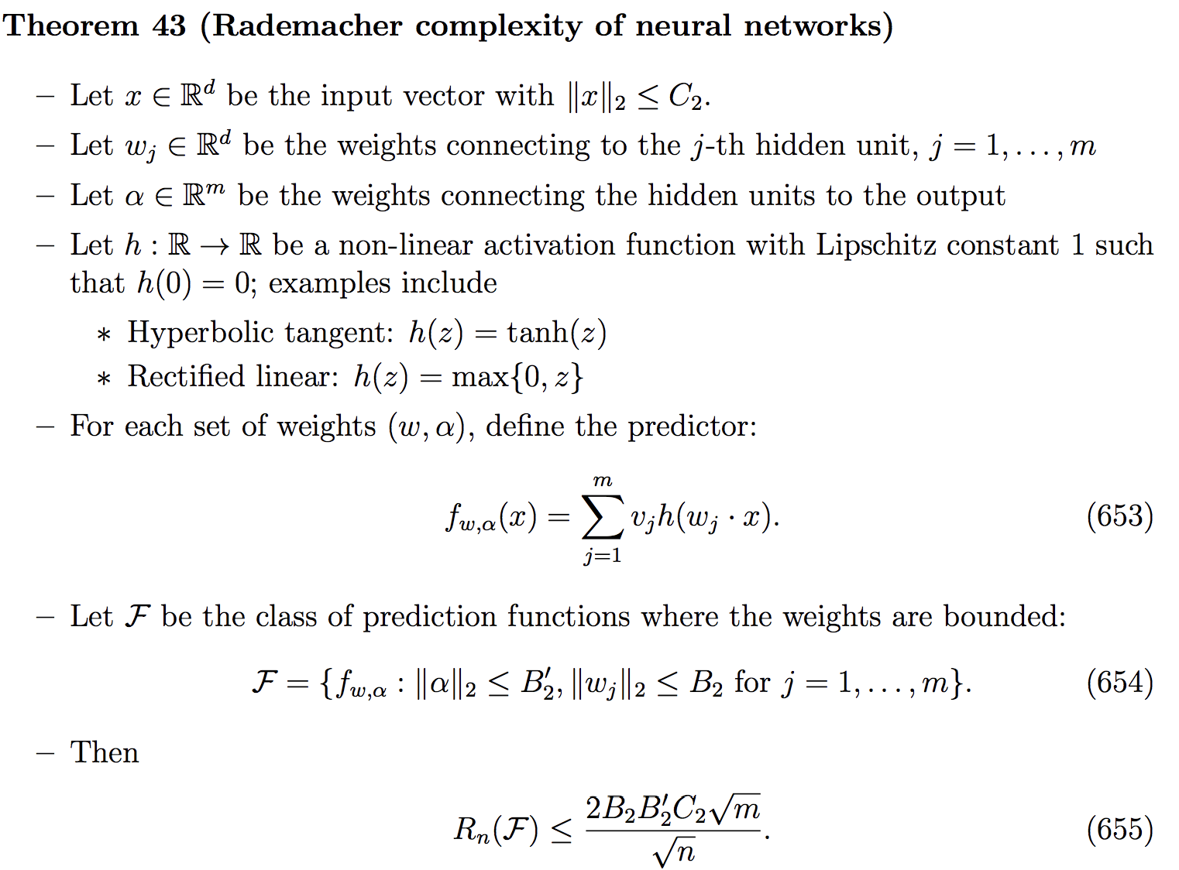
Rademacher complexity of NN
From notes of Percy Liang

Slide 5
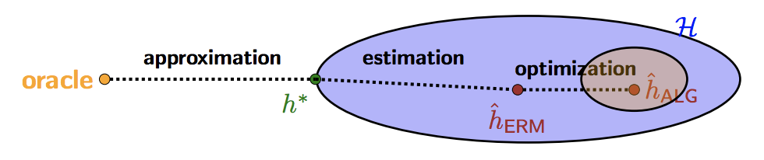
Decomposition of Errors
Derivation for linear regression

Slide 6
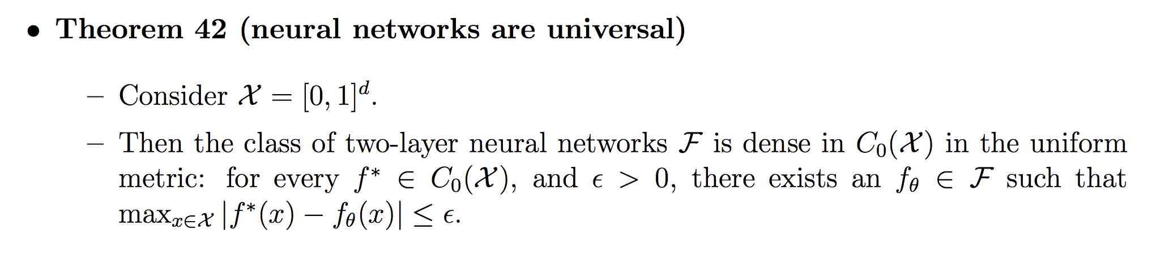
Universality of NN

Slide 7
Approximation in Shallow NN
Universality proof is loose: exponential number of units.
Better bound? Better basis?
How does it improve bound for various classes of functions?

Slide 8
Deep vs. Shallow Networks
What is the advantage of deep networks?
Compositionality: requires exponential number of units in a shallow network

Slide 9
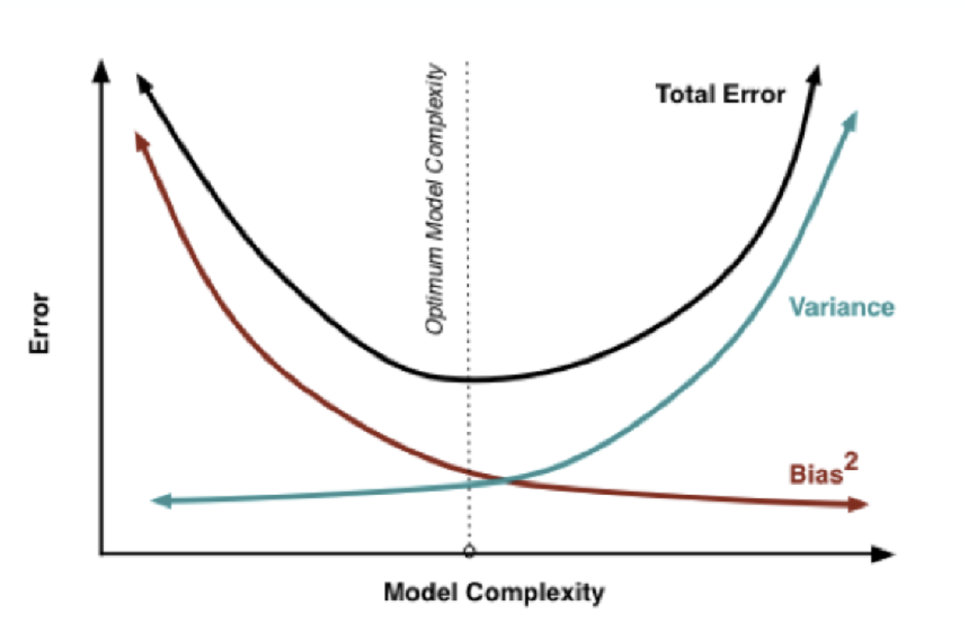
Classical NN theory

Slide 10
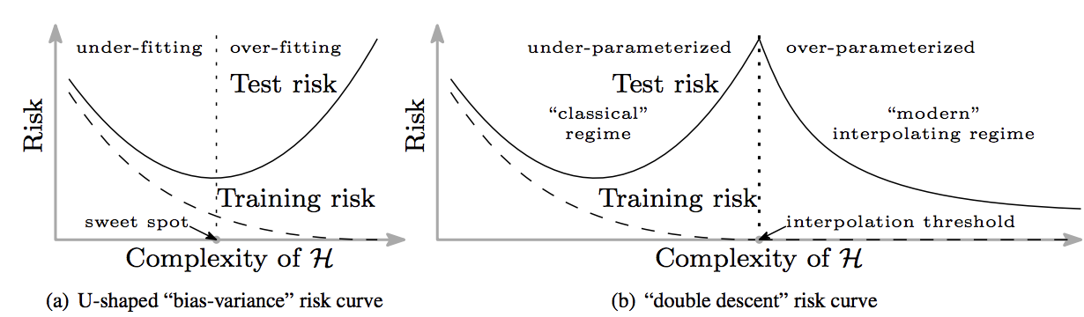
Modern Neural Networks
From Belkin etal, “Reconciling modern machine learning and the bias-variance trade-off”

Slide 11
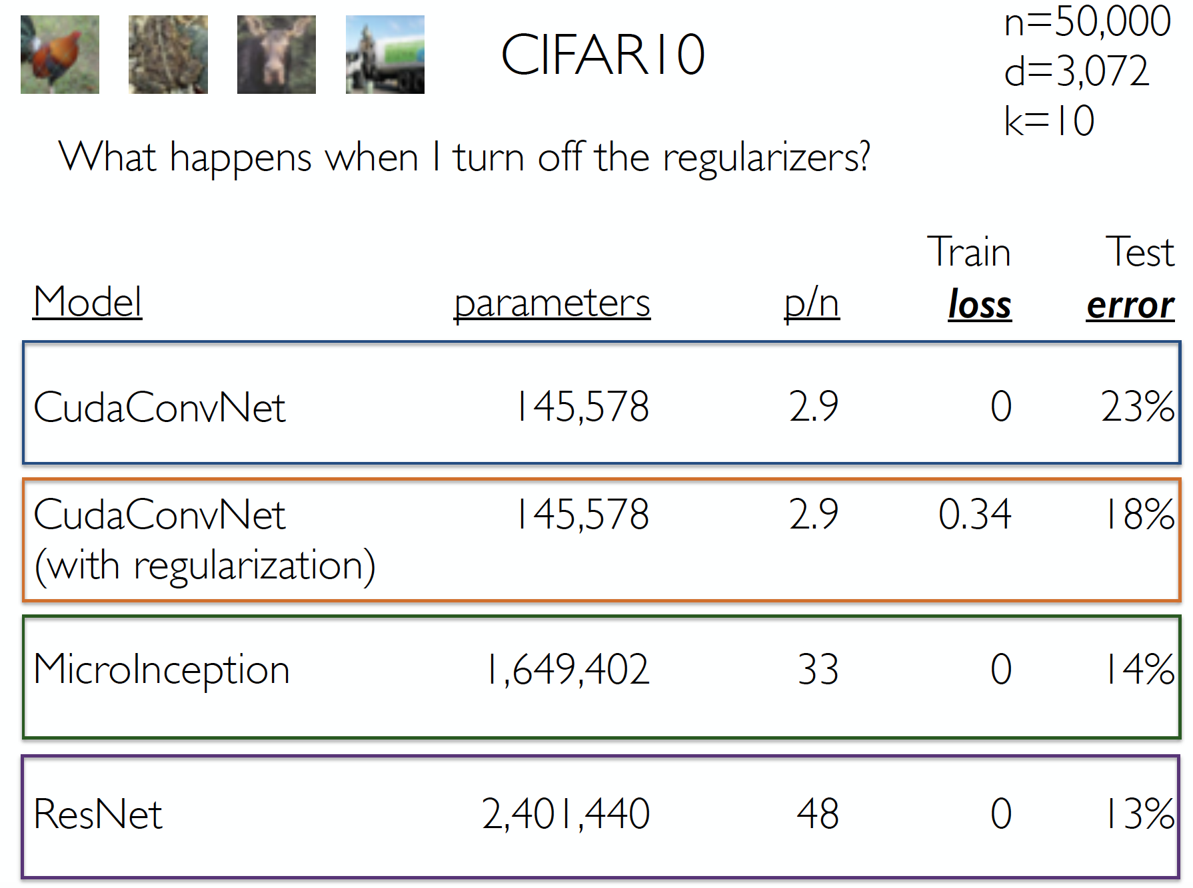
Seems to be true in practice
Slides from Ben Recht

Slide 12
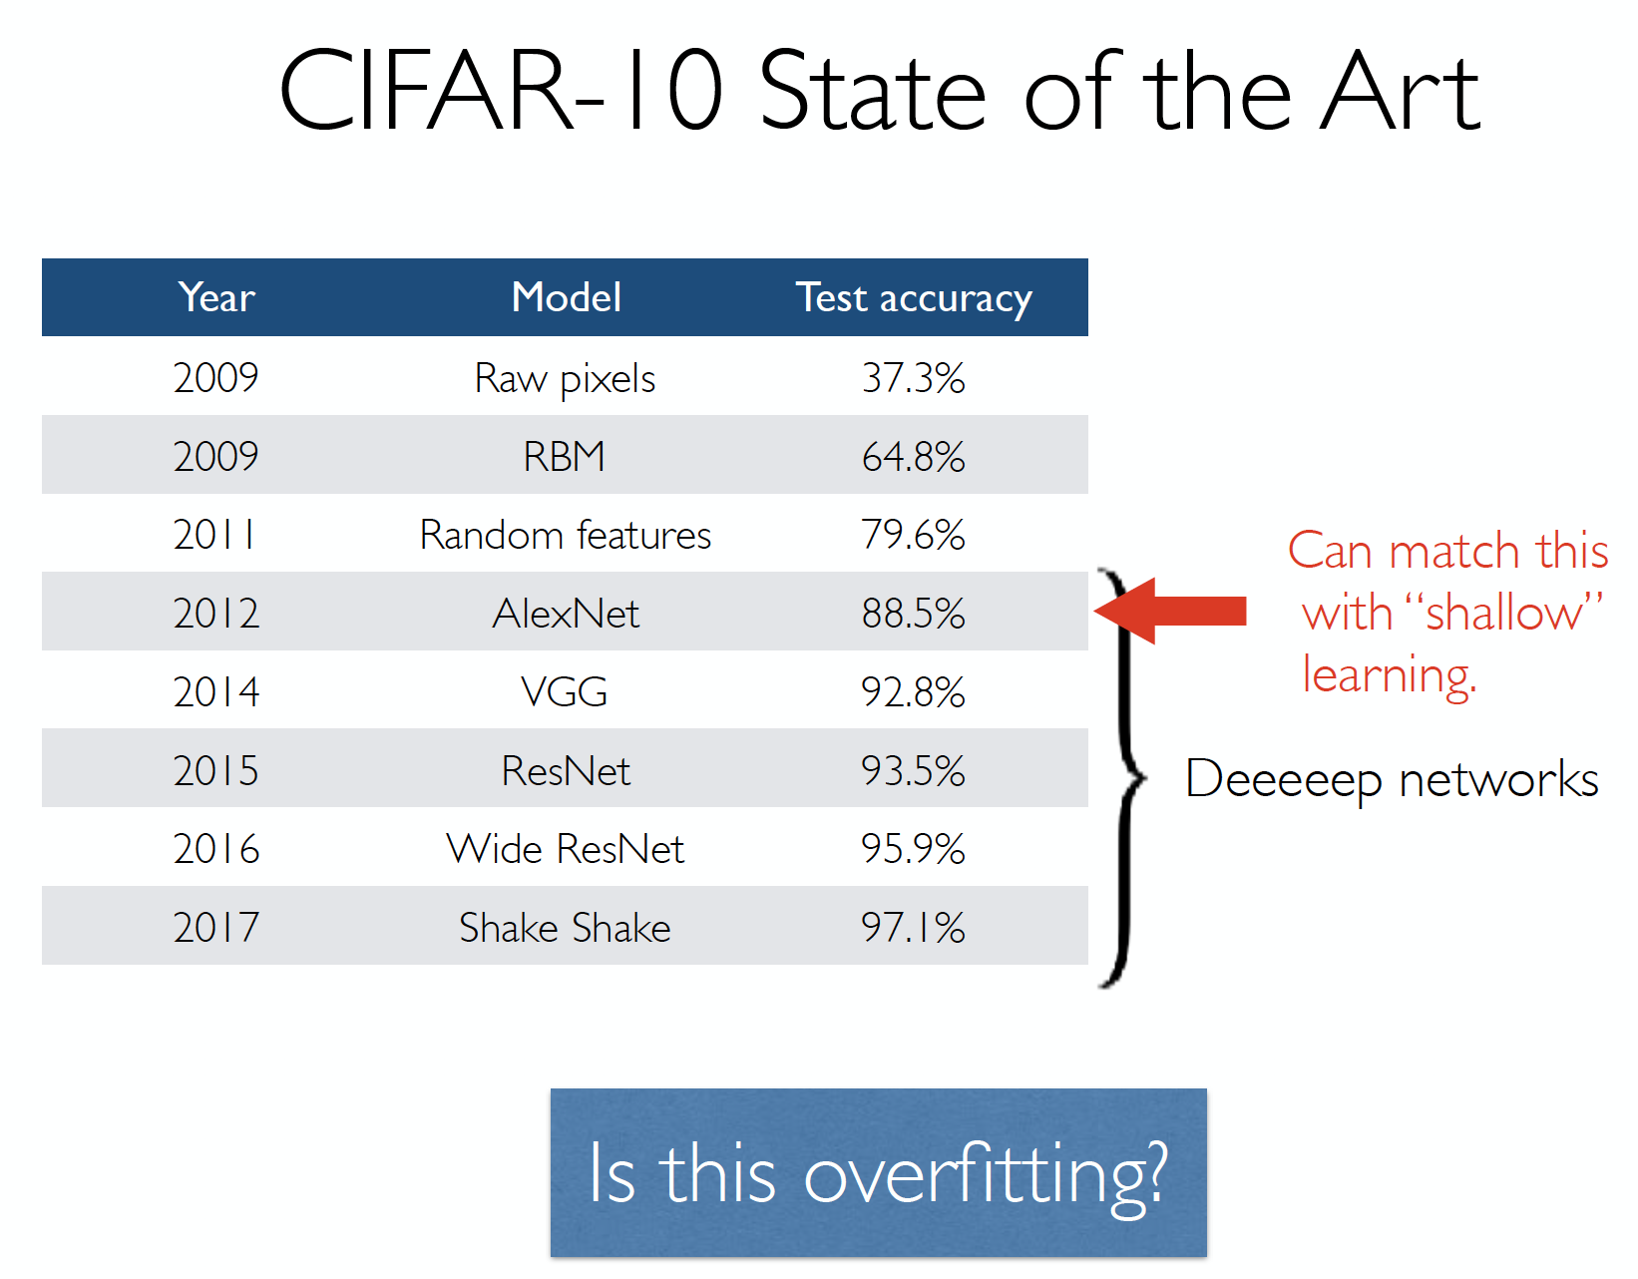
Is it really true?
Slides from Ben Recht

Slide 13
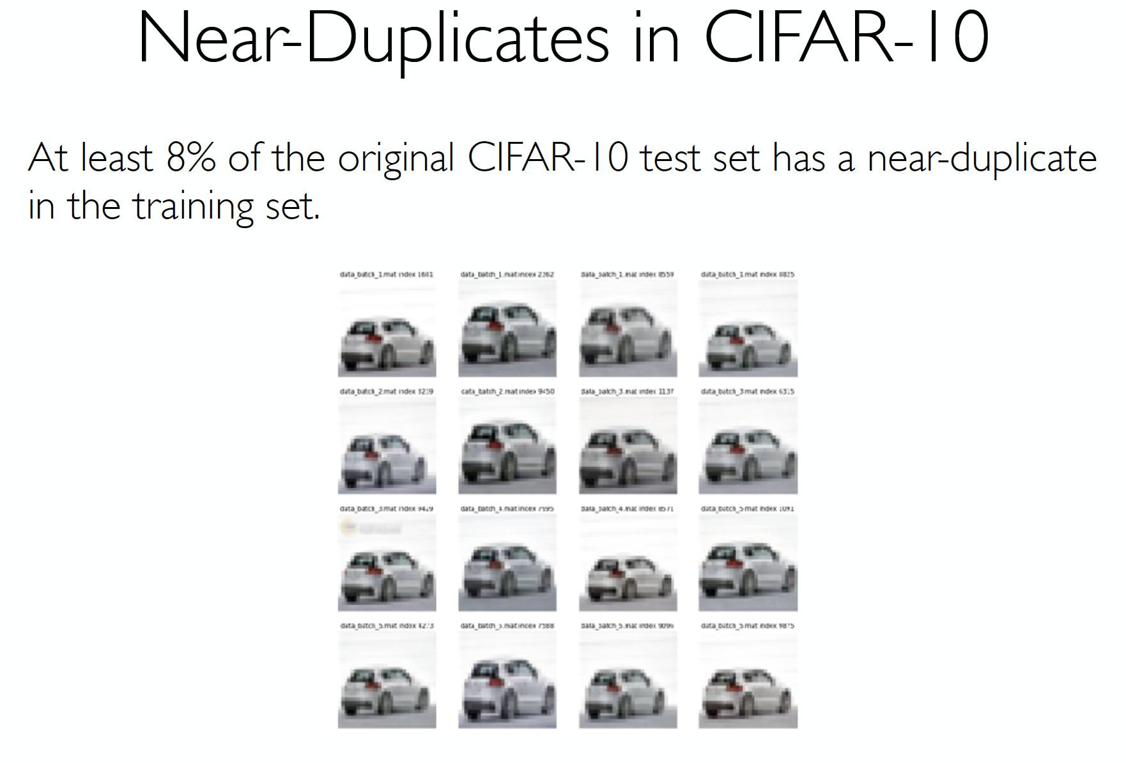
Look closely at data..
Slides from Ben Recht

Slide 14

Solution? Better Test Sets..
Slides from Ben Recht

Slide 15
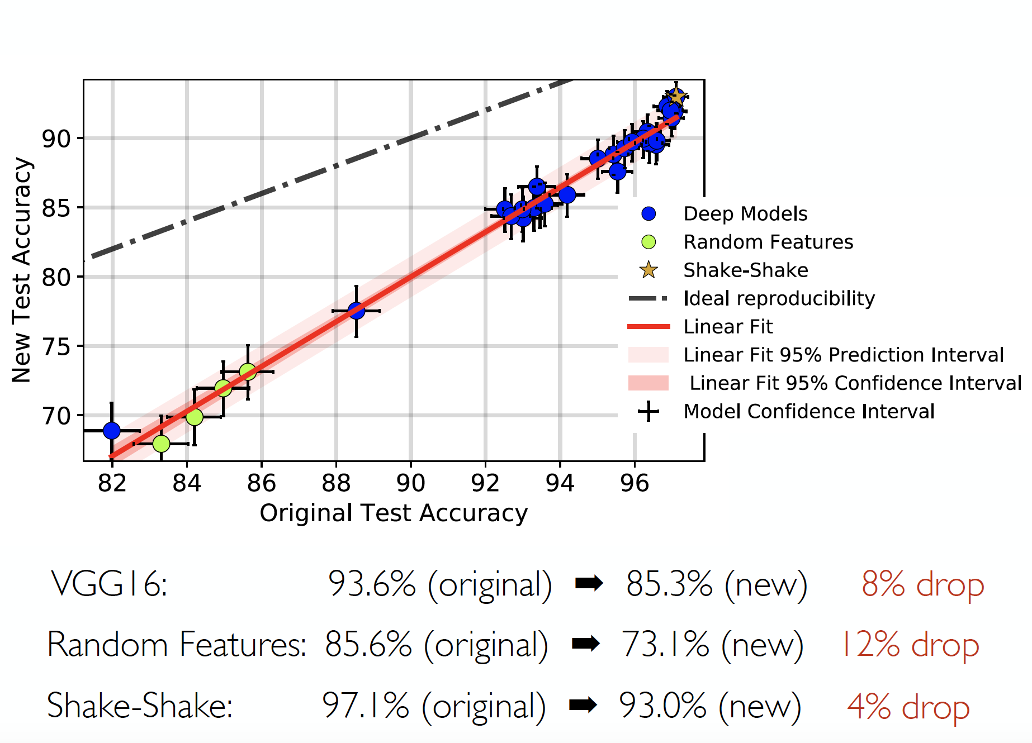
Accuracy on harder test set
Slides from Ben Recht

Slide 16
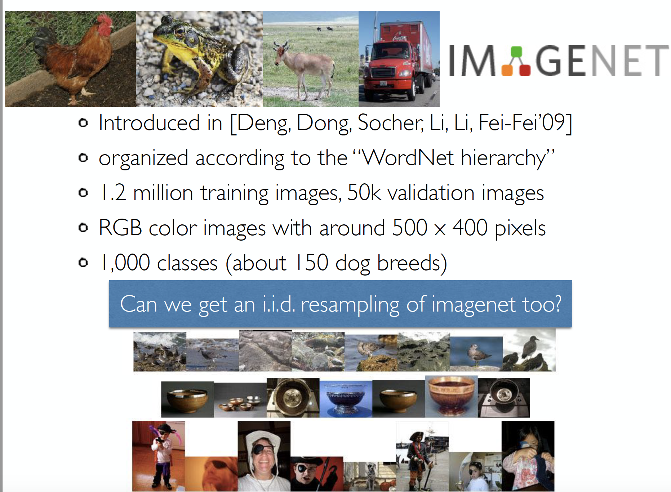
True even on Imagenet
Slides from Ben Recht

Slide 17
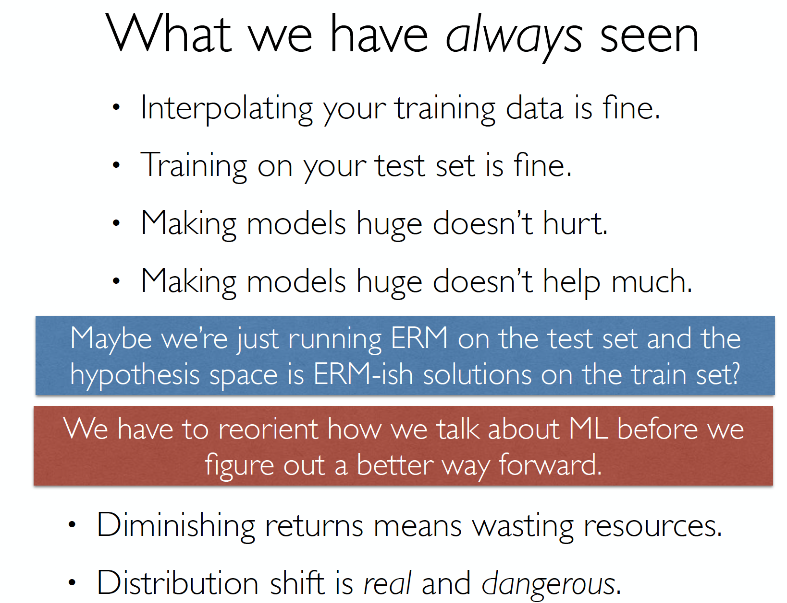
Is this a good summary?
Slides from Ben Recht

